Slide 1
LIFE Calls 2023 Sub-programmes and types of projects funded
LIFE Info Day Estonia 29/05/2023

Slide 2
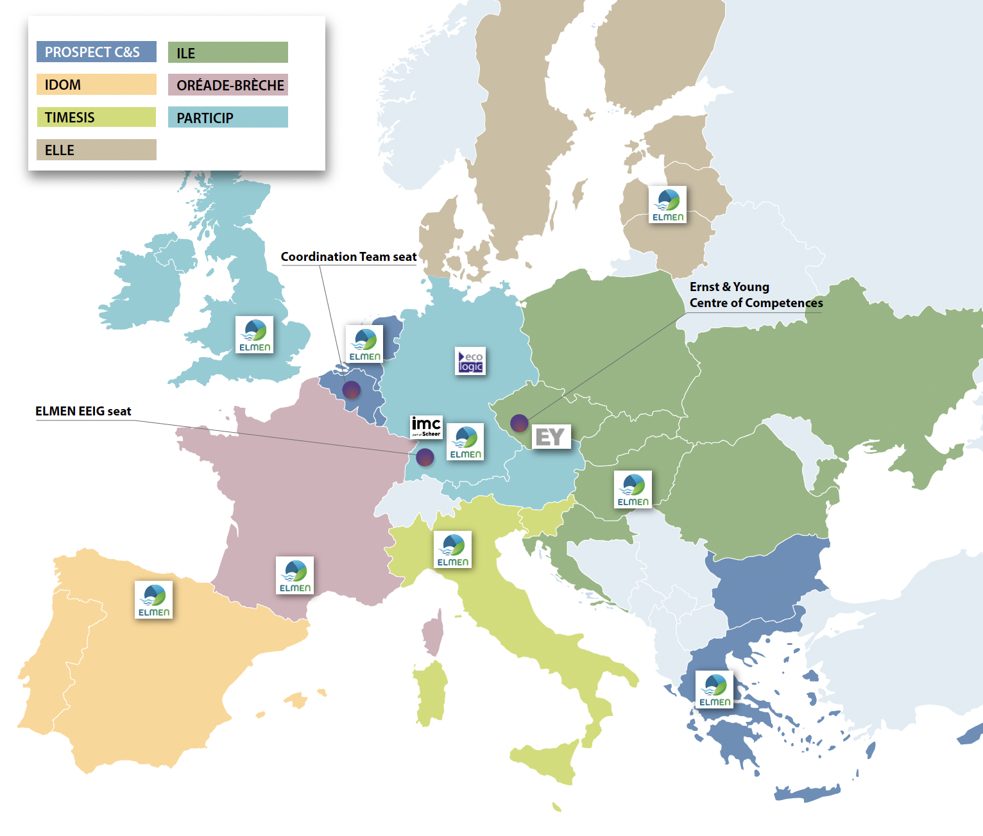

Slide 3
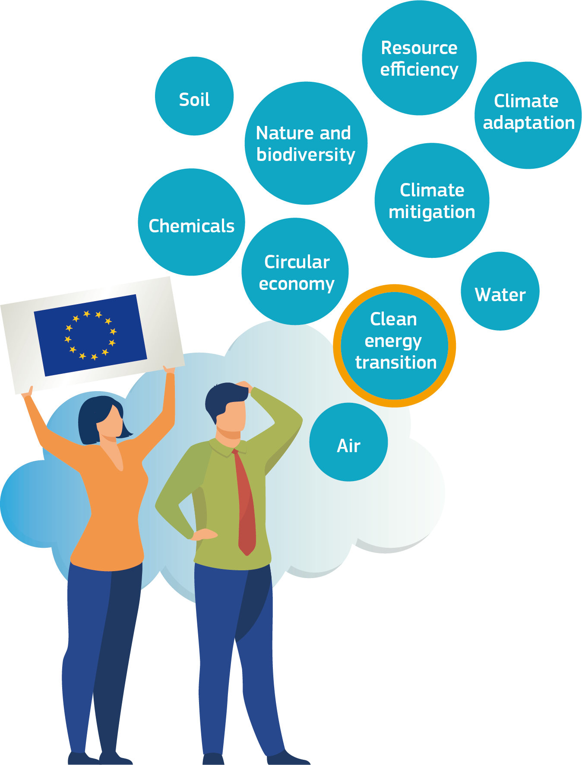
The LIFE programme
The LIFE programme constitutes a 100% contribution to the objectives and targets of the European Green Deal
The only EU programme dedicated exclusively to the environment, nature conservation and climate action
The multiannual work programme for 2021-2024 was adopted in July 2021
Budget of 5.43 billion € for the years 2021-2027
Budget of 611 million € for the call 2023

Slide 4
The LIFE Programme 2021-2027
Nature and Biodiversity
Projects
• Develop and demonstrate eco-innovative techniques and approaches
• Help to implement and enforce plans and strategies, in compliance with EU legislation.
• Promote best practices and behavioral changes
• Catalyse the large-scale deployment of successful solutions
To contribute to the shift to a circular, energy-efficient, renewable energy based- and climate resilient economy
Circular Economy
and Quality of Life
To protect and improve the quality of the environment
Their implementation on legislation and policies
• Support their development, monitoring and enforcement
• Help Member States to improve
Climate Change Mitigation and Adaptation
To halt and reverse biodiversity loss
Project beneficiaries are:
1/3 private enterprises
1/3 NGOs and civil society organisations
1/3 public authorities
Clean Energy Transition

Slide 5
Sub-programme Nature and Biodiversity
Typical actions
Projects supporting nature conservation and restoration in the Natura 2000 network
Species protection
Invasive Alien Species
Ecosystem restoration and much more …
Contribution to:
Nature and Biodiversity
Halting and reversing biodiversity loss
Supporting Natura 2000 network and Prioritised Action Frameworks
Mainstreaming nature and biodiversity objectives into other policies and financing programmes
Integrated implementation of PAF and Biodiversity Strategy
Financing of small-scale grants, particularly in Overseas Countries and Territories and Outermost Regions

Slide 6
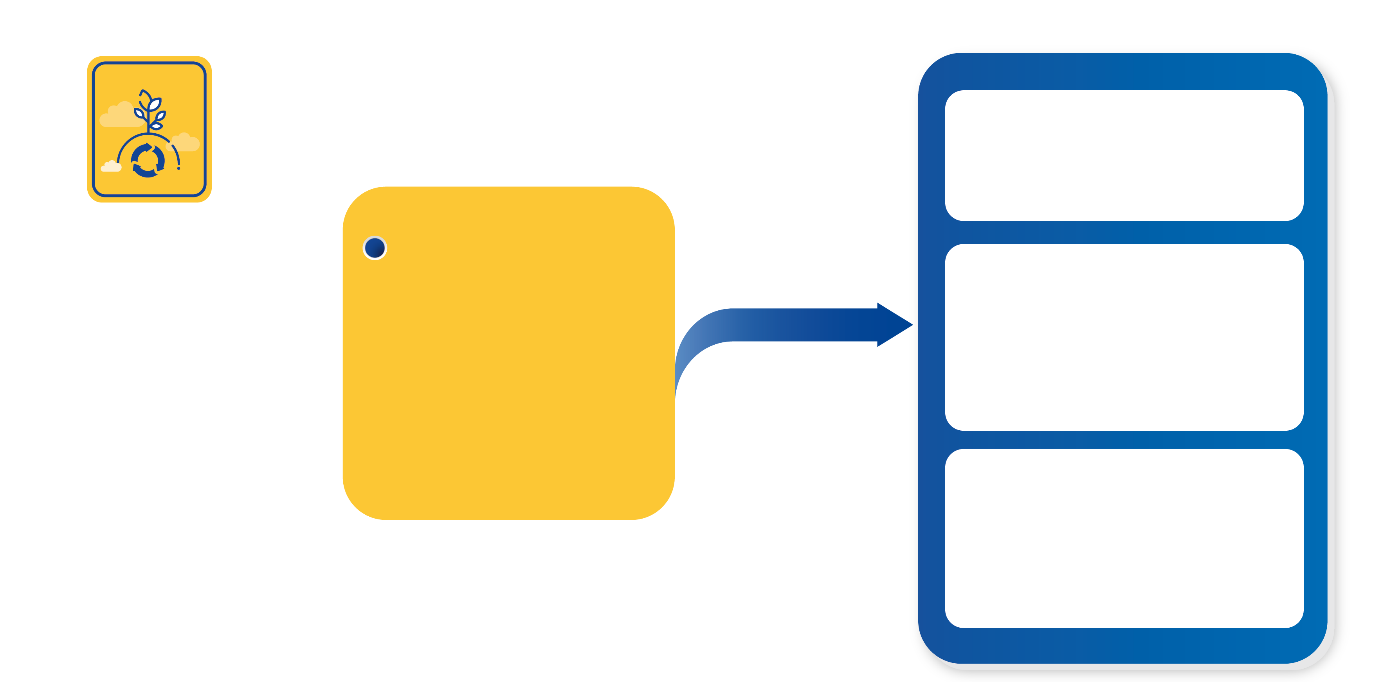
Sub-programme Circular Economy and Quality of life
Typical actions
Contribution in the areas of:
Support to public authorities and other stakeholders to implement EU environment legislation
Circular Economy
and Quality of Life
circular economy, noise, air, chemicals, industrial accidents, marine and coastal management, noise, soil, waste, water, and the urban environment
Support to technologies and solutions that are ready to be implemented in close-to-market conditions, at industrial or commercial scale
Integrated projects on air, water, waste and other areas such as circular economy
Promote upscale and access to finance

Slide 7
Sub-programme Climate Mitigation and Adaptation
On climate mitigation, projects that contribute significantly to the implementation of:
• the 2030 energy and climate policy
• EU Member States’ National Energy and Climate Plans
• EU climate and energy strategy
Contribution to:
Climate Change Mitigation and Adaptation
The transformation of the European Union into climate-neutral and -resilient society, through:
Climate Change Mitigation
Climate Change Adaptation & Related Governance
On climate adaptation:
• projects that supporting implementation of the new EU adaptation strategy and related national action plans

Slide 8
The sub-programme Clean Energy Transition predecessors: Intelligent Energy Europe continued under H2020- SC3- market uptake
Building policy and regulatory framework
Clean Energy Transition
Rolling-out technology, services and business models
Engaging and empowering consumers
Contribution to:
creating market & regulatory enabling conditions in the EU territories for the energy transition
Type of activities: developing and spreading best practice, mobilising investments, improving skills, removing market barriers, raising awareness, educating, empowering
Mobilising local and regional investments
Attracting
private finance

Slide 9
Clean Energy Transition: areas of intervention
Building a national, regional and local policy framework supporting the clean energy transition
Clean Energy Transition
Supporting the development of local and regional investment projects
Accelerating technology roll-out, digitalisation, new services and business models and enhancement of the related professional skills on the market
Involving and empowering citizens in the clean energy transition
Attracting private finance for sustainable energy

Slide 10
Types of activities funded under LIFE
Grants
Action grants:
Standard Action projects (SAPs)
Coordination and Support Actions (CSAs)
Strategic Nature Projects (SNaPs) not in 2023 call
Strategic Integrated Projects (SIPs)
Preparatory projects addressing ad hoc Legislative and Policy Priorities (PLP)
Technical Assistance (TA-PP and TA-RR)
Operating grants (call restricted to entities that signed a LIFE Framework Partnership Agreeement)

Slide 11
Standard action projects (SAPs)
«Traditional» LIFE projects aimed to:
develop, demonstrate and promote innovative techniques, methods and approaches
contribute to the knowledge base, the application of best practices
support development, implementation, monitoring and enforcement of the relevant Union legislation and policy
improving governance at all levels, enhancing capacities of public and private actors and involvement of civil society
large-scale deployment of successful technical and policy related solutions for implementing the relevant Union legislation and policy
replicating results, integrating related objectives into other policies and into public and private sector practices, mobilising investment and improving access to finance
Co-financing rate of 60% maximum except:
67% for projects targeting both priority and non-priority habitats and/or species
75% for projects targeting exclusively priority habitats and/or species
Maximum 10-year duration

Slide 12
Strategic Integrated Projects (SIPs)
Co-financing rate of 60% maximum
Maximum 14-year duration
Circular Economy and Quality of Life:
Circular Economy: national or Regional Circular Economy Action Plans, Strategies, Roadmaps or similar
Waste: national and regional Waste Management Plans and/or Waste Prevention Programmes
Water: River Basin Management Plans, Flood Risk Management Plans, Marine Strategies
Air: Air quality plans related to the Ambient Air Quality Directive, National Air Pollution Control Programmes
Climate Change Mitigation and Adaptation:
National Energy and Climate Plans
National Energy Efficiency Action Plans
National or regional adaptation strategies or action plans
Urban or community-based action plans aiming at the transition to a climate neutral and/or climate resilient society
National, regional or industry-/sector-specific greenhouse gas mitigation strategies or economy roadmaps contributing to climate neutrality

Slide 13
Strategic Nature Projects (SNaPs) → Not in 2023 call
Focused on the implementation of
the Prioritised Action Frameworks pursuant to the Habitats Directive
other plans or strategies adopted at international, national, regional or multiregional level by nature and biodiversity authorities
Co-financing rate of 60% maximum
Maximum 14-year duration

Slide 14
Operating grants for NGOs
Two-step application
Framework partnership agreement (FPA) - successful applicants sign a long-term agreement (3 years – 2022-2024) – NOT in 2023 call
Specific grant agreement (SGA). Only organisations that sign an FPA can be considered for SGA
Co-financing rate of 70% maximum
Maximum duration for SGAs - 1 year

Slide 15
Technical assistance projects (TA-PP)
TA-PP: support to the preparation of SNaPs and SIPs (TA-PP)
Co-financing rate of maximum 60%, maximum LIFE contribution of EUR 70 000

Slide 16
Technical assistance projects for replication(TA-R)
TA-R: LIFE Technical Assistance for Replication (i) NOVELTY
Preparation for facilitating the up-scaling and replication of results from other projects funded by the LIFE Programme, its predecessor programmes or other EU funding programmes
For the LIFE23 Call only proposals in the field of ‘Environment’ (i.e. ‘Nature and Biodiversity’ and ‘Circular Economy and Quality of Life’)
The TA-R projects could co-finance the activities necessary:
(1) to prepare or remove barriers to the up-scaling and/or replication of the results of previous LIFE projects or of other Union programmes, as long as they contribute to the objectives of the LIFE programme.
(2) to facilitate the access of an action contributing to the LIFE objectives, to other financial instruments.

Slide 17
Technical assistance projects for replication (TA-R)
TA-R: LIFE Technical Assistance for Replication (ii) NOVELTY
it should exceed the replication/transfer efforts and objectives foreseen in the preceding LIFE project
it should address issues emerging during a LIFE project that could not be solved during its duration, despite being extremely relevant for the success and sustainability of the project’s results
In case of proposals based on other EU-funding programmes, similar criteria will be applied
Only proposals in the field of ‘Environment’ (i.e. ‘Nature and Biodiversity’ and ‘Circular Economy and Quality of Life’) – for the LIFE23 call
60% co-funding
Budget of the call 6.5 M€
Opening: April 2023 / Deadline for submission: 27 July 2023
Grant Agreement signature foreseen around February - March 2024

Slide 18
Other action grants
Coordination and Support Actions for the transition to renewable energy and increased energy efficiency
A Small Grant Facility on Biodiversity (BEST); small grants (max EUR 100 000, 100% EU funding) in the Outermost Regions and the Overseas Countries and Territories for biodiversity
Action grants benefitting the organisations mentioned in Annex I of the LIFE Regulation
Co-financing rate of 95% maximum, except Small Grant Facility on Biodiversity (100%)

Slide 19
Calls 2023 – Overview
Call | Enveloppe indicative (M€) | Opening date | Closing date | Indicative grant signature date
SAP – Nature and Biodiversity | 148,4 | 18/04/2023 | 06/09/2023 | June 2024
SAP – Circular economy and quality of life | 81 | 18/04/2023 | 06/09/2023 | June 2024
SAP –Climate Mitigation and Adpatation | 66,3 | 18/04/2023 | 21/09/2023 | June 2024
CSA – Clean Energy Transition | 99 | 11/05/2023 | 16/11/2023 | June 2024

Slide 20
Call | Enveloppe indicative (M€) | Opening date | Closing date | Indicative grant signature date
SNaP – Strategic Nature Projects | No call in 2023
SIP - Circular economy and quality of life | 52,8 | Phase 1 (Concept Note): 18/04/23 Phase 2 (Full Proposal): November 2023 | Phase 1 (Concept Note): 05/09/23 Phase 2 (Full Proposal): 05/03/24 | November 2024
SIP – Climate Mitigation and Adaptation | 30 |  | Phase 1 (CN): 05/09/23 Phase 2 (FP): 05/03/24
PLP – Policy and Legislative Priorities Projects | 14,9 | 18/04/2023 | 07/09/2023 | November 2023 (Bauhaus-Phoenix-Emerald) March 2024 (the others)
TA-PP | 0,9 | 18/04/2023 | 07/09/2023 | December 2023
TA-R | 6,5 | 18/04/2023 | 27/07/2023 | March 2024

Slide 21
Key Challenges
There is significant competition for LIFE funds
New IT environment and applications forms
Funding & tender opportunities portal at https://ec.europa.eu/info/funding-tenders/opportunities/portal/screen/home
Proposals that fail are either poorly prepared or simply with limited ambition or risk taking
But: Key to success is always the same!

Slide 22
Must read
LIFE Web site https://cinea.ec.europa.eu/life_en – LIFE project database
Call documents (Funding & tender opportunities portal)
LIFE Regulation and Multi-annual work-programme https://eur-lex.europa.eu/legal-content/EN/TXT/?uri=celex%3A32021R0783 ; https://cinea.ec.europa.eu/programmes/life/life-legal-basis/life-multiannual-work-programme-2021-2024_en
Specific information, guidelines designed by your National Contact Point https://life.envir.ee/et/english

Slide 23
Project Design Full Proposal
Good design
Common problems
Solid analysis of the problem, state of play and solution proposed (baseline)
Insufficient background information (why, who and how)
Rationale for projects is defined during the project
Key stakeholders involved (incl. users)
Objectives too broad, too many
Poor partnership (partners do not fit regarding know-how or insufficient budget)
Robust assessment of impacts over the life cycle of the solution proposed
Over-optimistic / unrealistic or lack of quantification of impacts
Replication confused with networking and dissemination
Clear strategy on how to sustain and multiply the impacts
Vague plans to sustain the project/results after project end

Slide 24
Thank you
Inta Duce
inta.duce@elmen-eeig.eu
ELMEN EEIG

