Slide 1

LIFE EBP
Ecofriendly multipurpose Biobased Products from municipal biowaste
Freddy Liendo

Slide 2
Project Overview
LIFEEBP
in numbers
15 Partners
5 countries
4 years:
Oct 2020 - Sep 2024
Total eligible amount: €3,801,989)
EC FC requested: €2,091,086 (54.93 %)
9 Work packages (Actions)
LIFEEBP Project is focussed on the valorisation of municipal biowaste (MBW) as feedstock to produce new biobased products (BPs) for agriculture and the chemical industry applications.
The project will develop a mobile prototype to process the necessary MBW t/y (5 kt/yr of MBW).
The LIFEEBP process will be validated in a real environment four different countries (Italy, Spain, Greece and Cyprus), in 5 different locations (ACEA, Biomasa Peninsular, TETma, Vrilissia Municipality and SBLA) using local MBW.
Notes:
Total eligible project budget: 3,801,989 Euro
EU financial contribution requested: 2,091,086 Euro (= 55.00% of total eligible budget)

Slide 3
Project Methodology
LIFEEBP will last 48 months, from October 2020 till September 2024. To achieve its objectives, LIFEEBP has been divided into 9 interrelated Actions.
B. Implementation actions
  B1 On-site operation of mobile prototype (MP) producing BPs in Italy, Spain, Greece and Cyprus
  B2 BPs and IR testing
  B3 Life cycle environmental (LCA) and economic (LCC) assessment
  B4 Process/product regulatory certification (RCA) and social life cycle (S-LCA) assessment
C. Monitoring of the impact of the project actions
  C1 Monitoring of project impact
D. Public awareness and dissemination of results
  D1 Project communication strategy set-up and implementation
E. Project management
  E1 Project management by Hysytech
  E2 Monitoring of project progress
  E3 After Life Communication Plan, Transferability and Replicability Plan, Exploitation and Business Plan

Slide 4
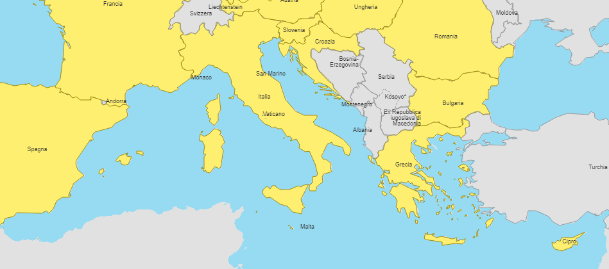
Consortium
A consortium that involves the whole society/stakeholders with complimentary expertise:
Public sector: 3 municipalities
Companies: 5 Small and medium enterprises, 2 Large enterprises
Academia: 5 Universities
Partner N° | Partner name | Short name
1 | Hysytech Srl | HST
2 | ACEA Pinerolese Industriale S.p.A. | ACEA
3 | Allegrini SpA | AL
4 | Agricultural University of Athens | AUA
5 | Societe D’extrusion Du Polyethylene A.Barbier Et Cie | BB
6 | BIOMASA PENINSULAR S.A. | BPE
7 | Castellón City Council | CM
8 | Cyprus University of Technology | CUT
9 | POOL.ITI S.r.l. | POOL
10 | Sewerage Board of Limassol - Amathus | SBLA
11 | Técnicas y Tratamientos Medioambientales, S.A.U. | TETma
12 | Università degli Studi di Catania | UNICT
13 | Università degli Studi di Roma Unitelma Sapienza | UNITELMA
14 | UNIVERSITA DEGLI STUDI DI TORINO | UNITO
15 | Municipality of Vrilissia | VM
Notes:
LIFEEBP consortium will: (i) build the MP, (ii) validate/replicate BPs/IR production process at large scale in Italy, Spain, Greece, Cyprus, (iii) validate/replicate BPs and/or IR performance as soil fertisers/plant biostimulants, surfactants in industrial cleaning products and biopolymer in plastic materials in France and above 4 countries, using industrial equipment and involving customers of Acea, BB and AL industrial beneficiaries

Slide 5
How we got funding?
W4P project was submitted in 2018 to the life program Commission the concept.
  This addressed environmental problems in the management of municipal biowaste (MBW) and in agriculture. The project was rejected because the expected environmental benefits from these sectors were judged quantitatively not enough to justify the requested Commission contribution.
In 2019, we submitted the concept note of LIFEEBP addressing the environmental problems in the same sectors of the W4P projects and also in the chemical industry sector. We kept the same budget in W4P: i.e. € 3744 total, € 2051 EU contribution for 16 partners in W4P versus € 3807 total, € 2091 EU contribution for 15 partners in LIFEEBP.

Slide 6

Project motivation
01
Emissions due to waste disposal (landfill)
02
Operating costs and low scale
Waste Management challenges
03
Energy efficiency (<54%)
04
Low market prices of plastics and fertilizers
05
Remaining toxic hazardous components
06
No Govern, social, financial incentives

Slide 7
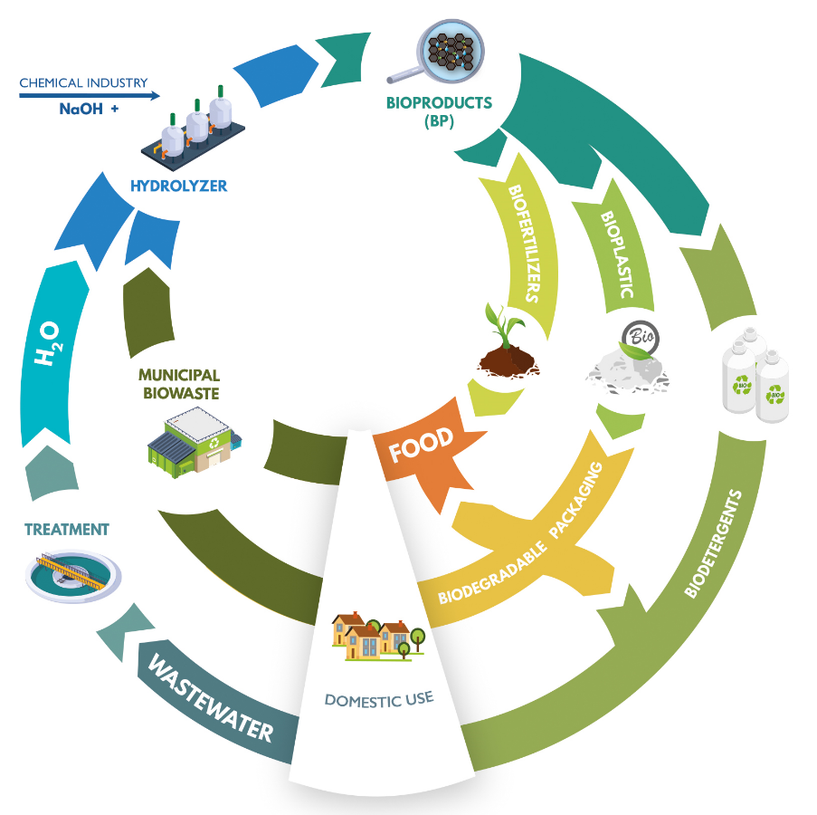
Main Goal
Demonstration of environmental, economic and social benefits of the biobased products and the insoluble residue in the sectors of MBW management, agriculture, and chemical industry in 5 EU countries, taken as case studies, by:
  replicating BPs/IR production process in real operational conditions using local MBW as feedstock;
  validating BPs/IR performance in different applications, such as soil fertilizers, plant biostimulants/anti-pathogen agents, biopolymers to make plastics, surfactants to make detergents;
  confirming BPs/IR compliance with EU regulation to register BPs/IR according to Waste Management Policy, Common Agriculture Policy and REACH Policy;
  assessing BPs/IR marketability.
Based on I results, develop an after-project-plan to establish joint ventures among stakehoders in the sectors of waste management, agriculture and chemical industry and promote industrialisation of BPs/IR production and uses in all EU countries.
Notes:
BPs and IR mean the soluble bio-based polymeric products and the insoluble residue

Slide 8
Objectives and concept
OBJECTIVES & SCOPE
Main objectives: reduce environmental impacts from Municipal Biowaste (MBW), mineral fertilisers (MF), synthetic chemicals (SC)
Solution(s) proposed: produce new biobased products (BPs) from MBW and use BPs in place of MF and SC
Key actions: validate BPs production and use in 5 partners countries - demonstrate process/product replicability in different real operational environments

Slide 9
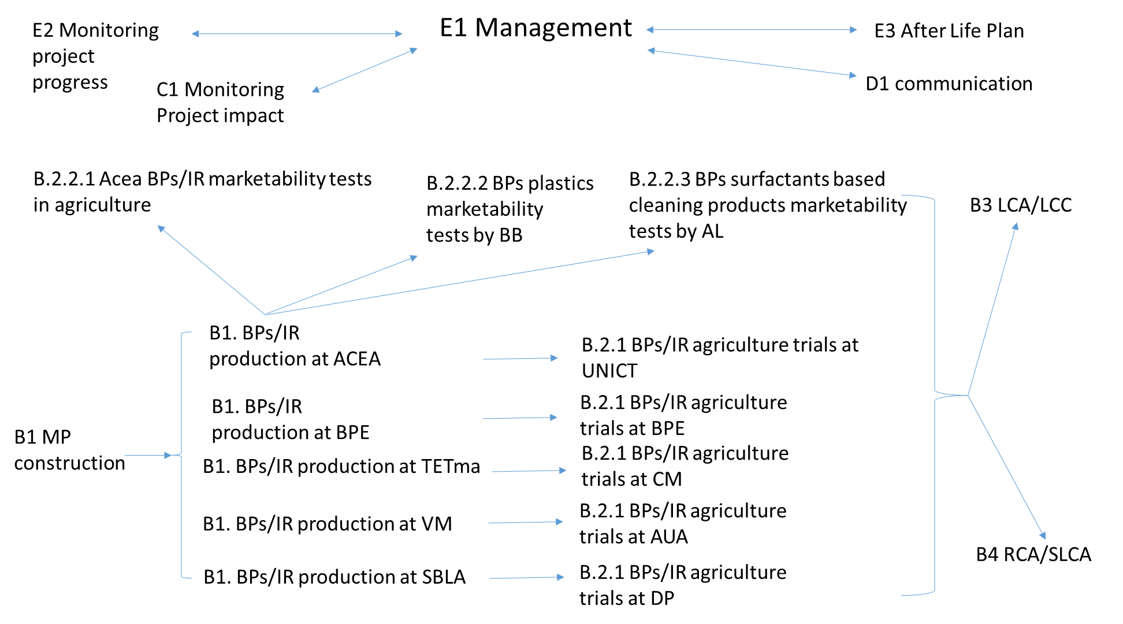
Actions and partners organisation

Slide 10
EXPECTED IMPACTS: Potential Maximum Values achievable during and after project
Indicator | During Project | 5 years After Project
CO₂ reduced production | 21 kt/yr | 164 Mt/yr
CH₄ reduced production | 458 t/yr | 2 Mt/yr
NH₃ reduced production | 1.2 t/yr | 423 kt/yr
NO_{x} reduced production | 60 t/yr | 21 kt/yr
NO₃⁻ reduced production | 14 t/yr | 14 kt/yr
MBW reduced production | 5 kt/yr | 100 Mt/yr
KOH reduced consumption | 115 t/yr | 2.3 Mt/yr
Water reduced consumption | 20 k m³/yr | 400 M m³/yr
Energy reduced consumption | 17 Mkwh/yr | 182 billion kwh/yr
Sustainable agriculture land use | 100 kha | 175 Mha
Jobs created | 20 | 373000
Replication/transfers | 5 | 4000
Market size/number of customers | 40 | 28000
Expected revenues |  | 84-8400 billion €
Cost reduction of BPs vs. SC commercial products |  | 0.2 €/kg BPs against 3 €/kg bioplastics and 15-45 €/kg biosurfactants
Pay back time of CAPEX cost |  | Less than 1 year
Number of entities/individuals reached/ made aware | 20000 | Several tens of thousands

Slide 11
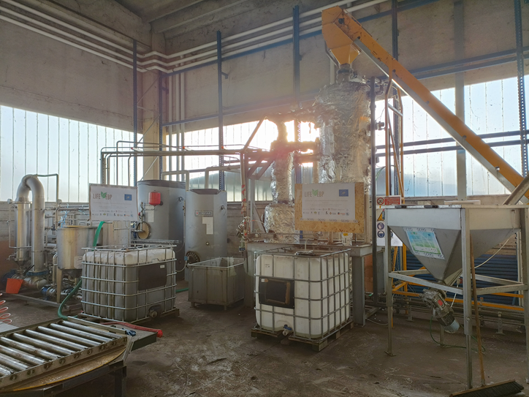
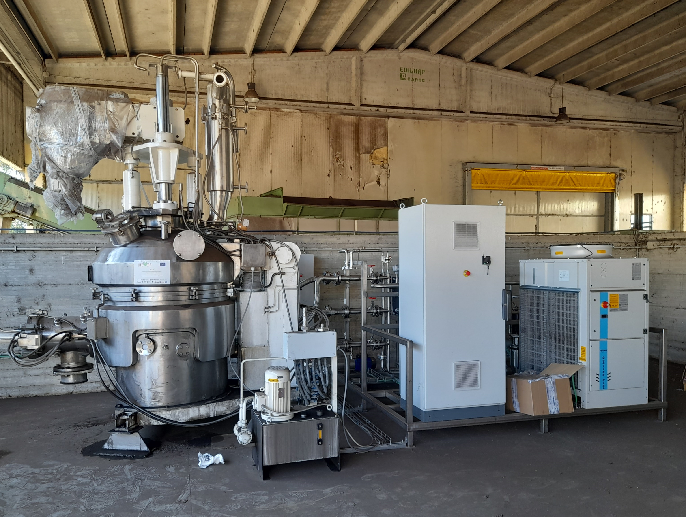
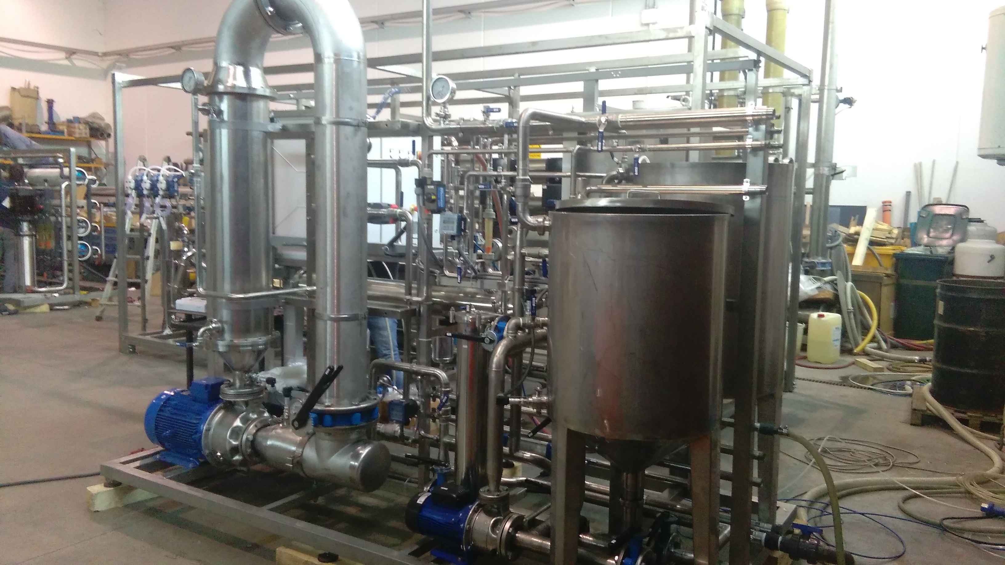
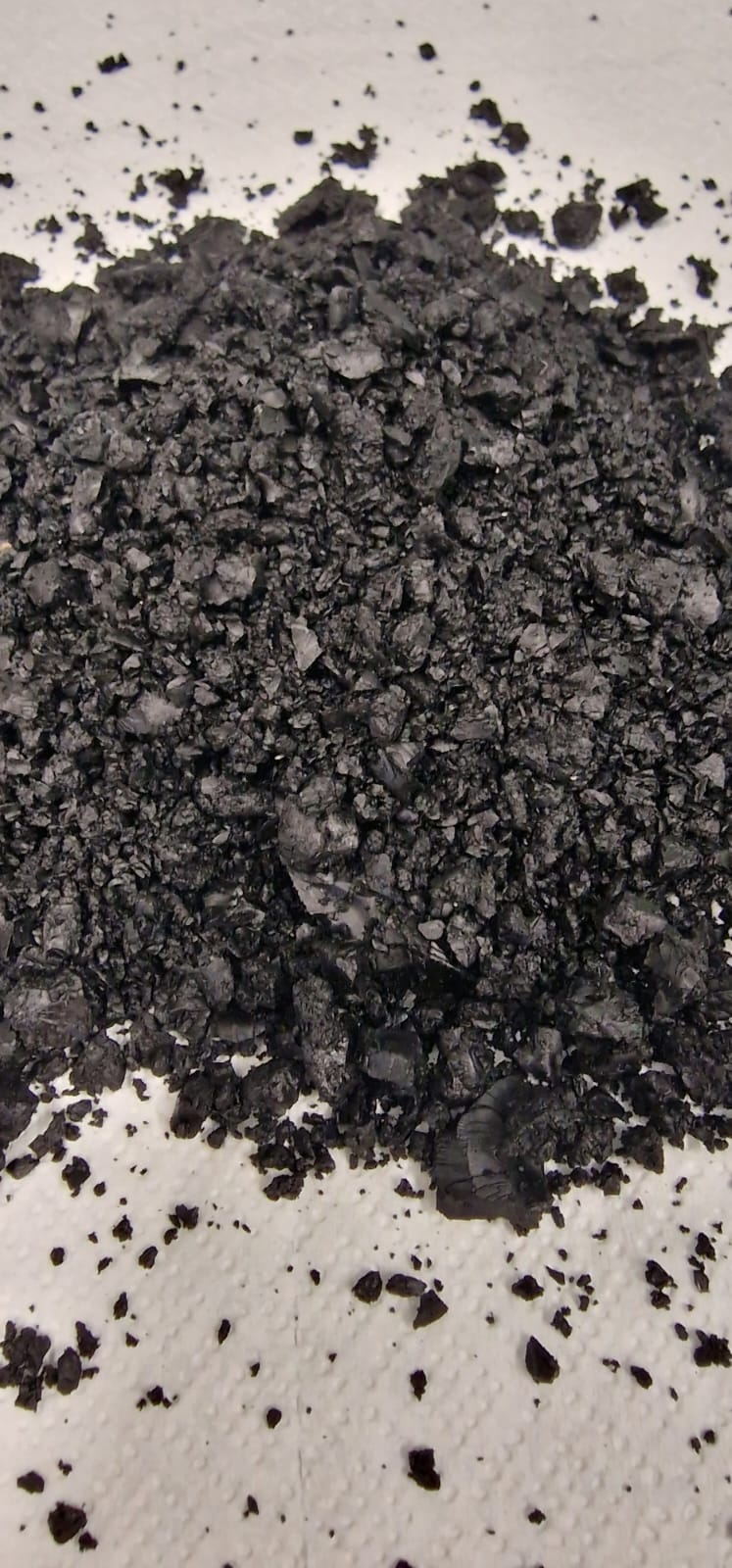
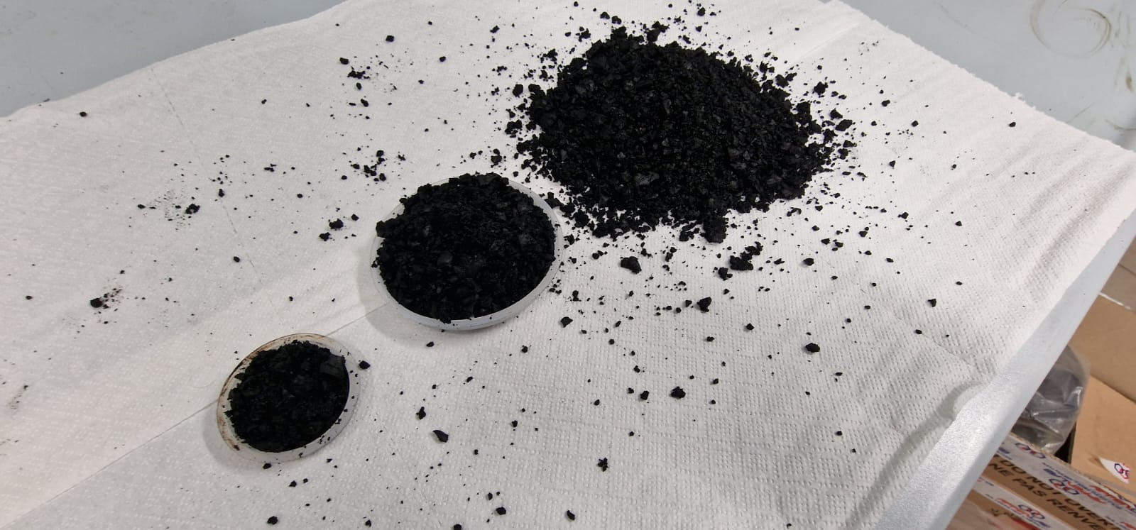
Project progress at M24
BPs production
Hydrolysis process
Drying system
Membrane purification system
Dried product (>80 kg)
To be applied in agriculture, plastics, and detergents.

Slide 12
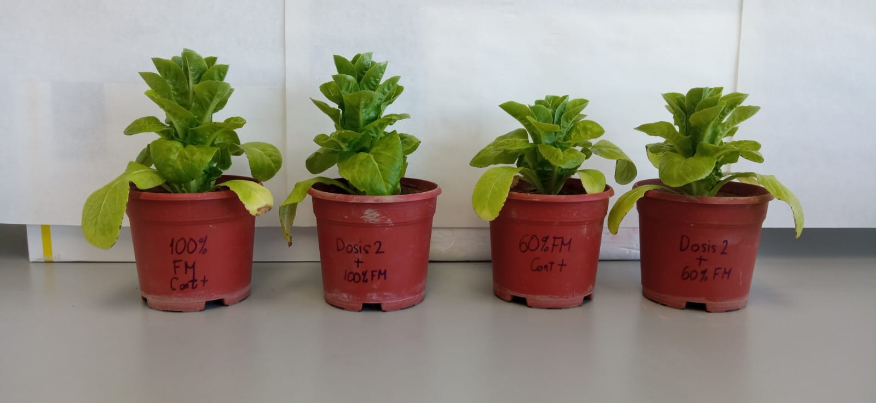
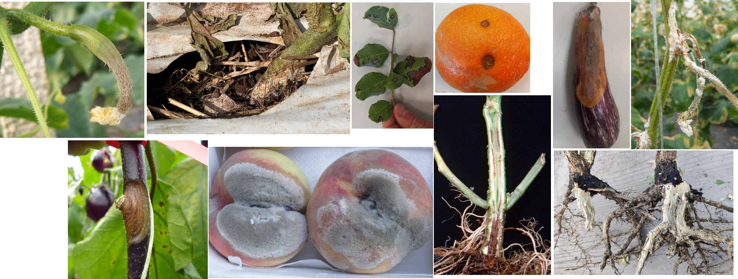
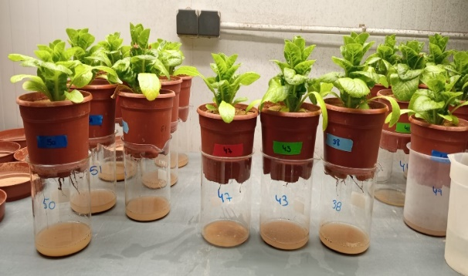
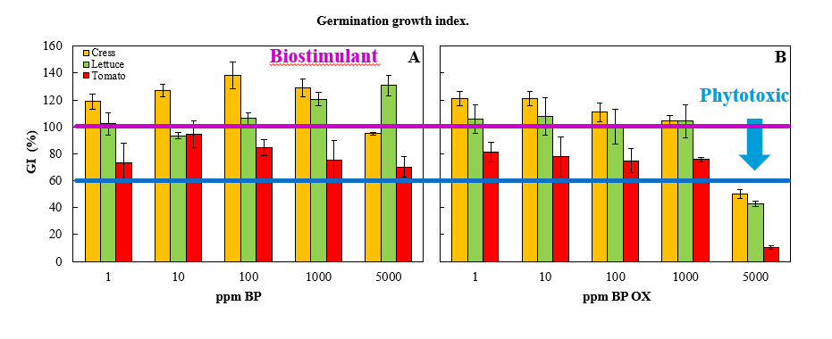
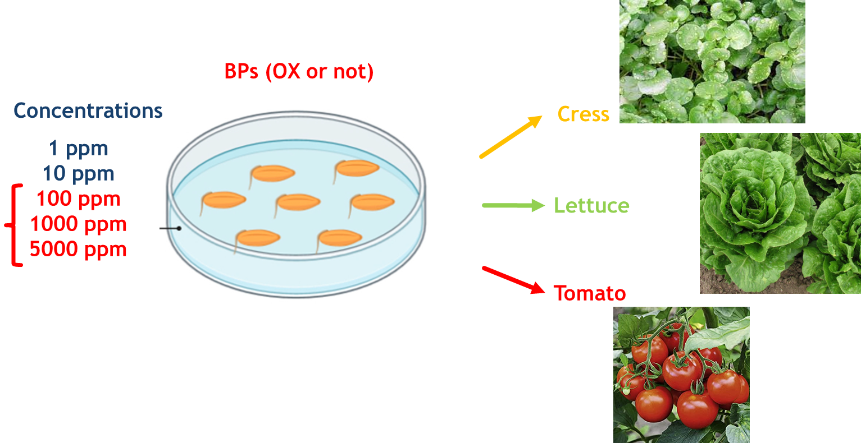
Project progress at M24
BP performance
Agriculture trials
  Antifungal properties
  Phytotoxic effect of BPs on seed germination
Agriculture trials
  Water retention capacity

Slide 13
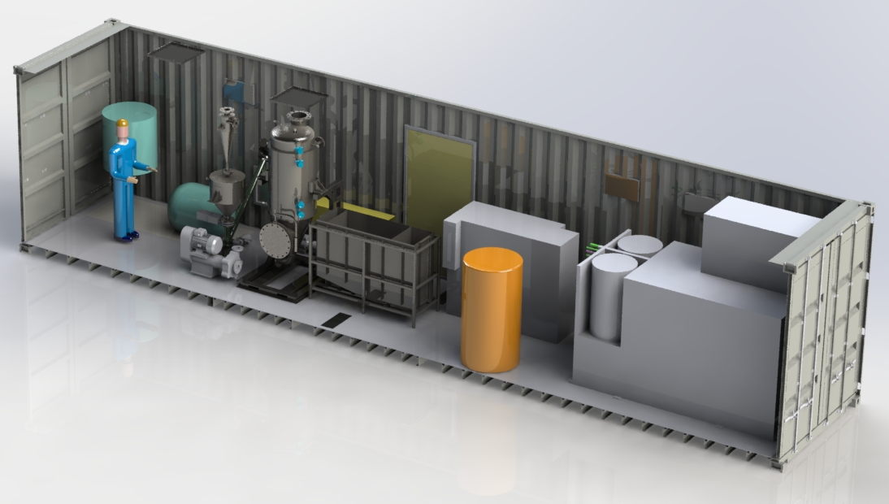
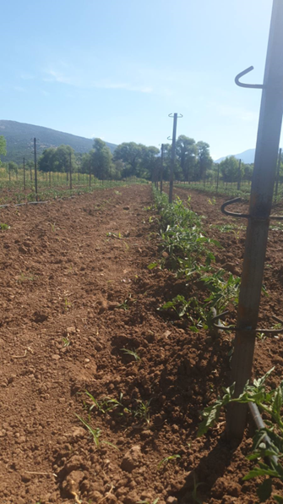
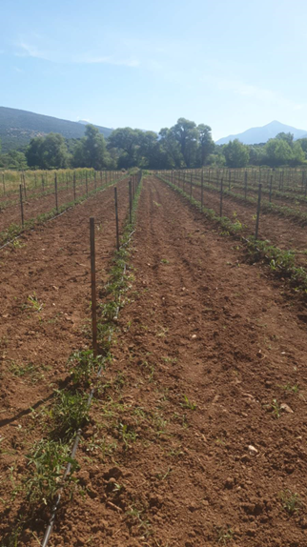
Next actions
BP production and testing
New prototype manufacturing and commissioning
BP production optimization for further applications
  Organic content of the final product
Field agriculture trials

Slide 14
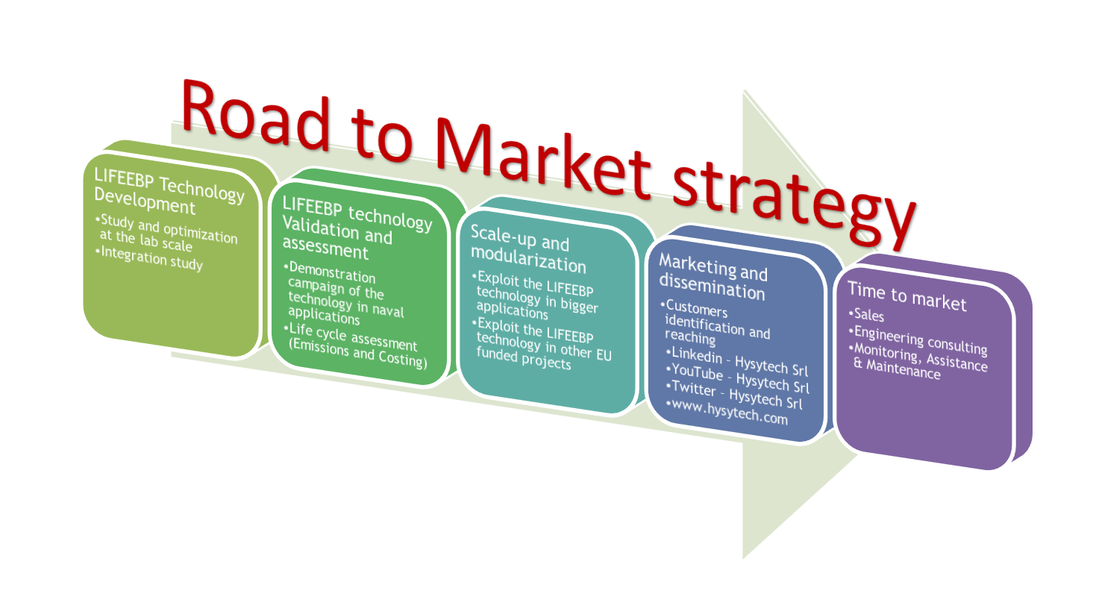

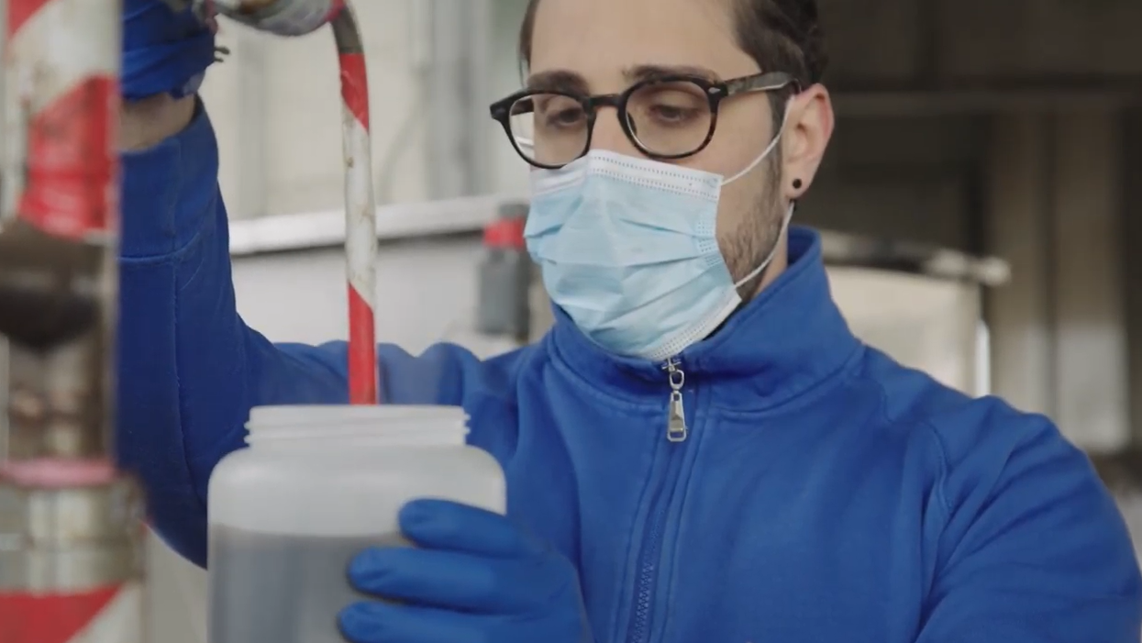
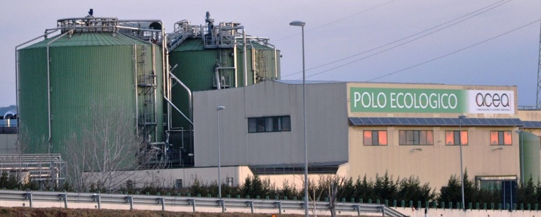
CONTINUATION (REPLICATION, TRANSFER, MARKET UPTAKE)
BP production
Product validation

Slide 15
Thank you
Freddy Liendo
freddy.liendo@hysytech.com
Simone Solaro
simone.solaro@hysytech.com

