Slide 1
Parks & Wildlife Finland
Mikko Tiira, Development manager
LIFE capacity building training
Tallinn, Estonia 15. – 16.12.2016

Slide 2
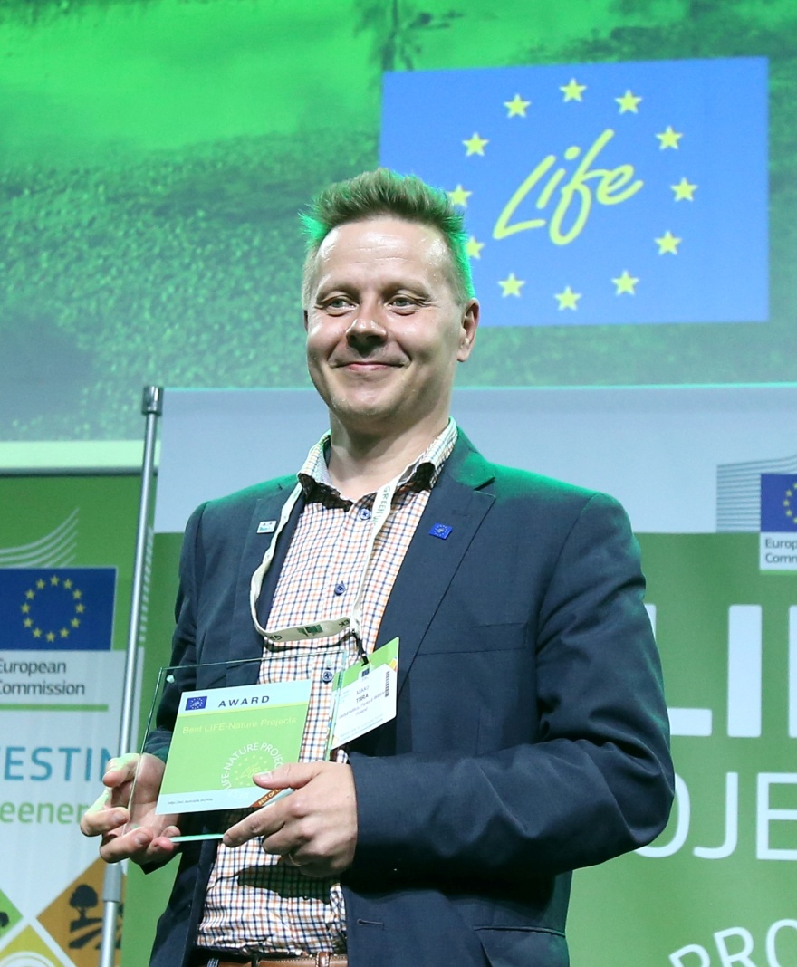
Mikko Tiira, the LIFE line
Engaged with LIFE since 1999
Currently Development Manager at MHPWF (MH since 2010)
  E.g. Project portfolio management, LIFE promotion (MH and National LIFE group)
WWF Finland, first NGO managed LIFE Project 2000 - 2003
LIFE Monitoring Team (Astrale GEIE) 2005 – 2009
  Finland, Estonia, Latvia, Lithuania and Poland
Unofficial National Contact Point 2010 -
LIFE trainer for National Info Days 2010 –
LIFE trainer for LIFE capacity projects and IP
  e.g. Denmark, Sweden, Estonia, Lithuania and Hungary
Managed 2 LIFE projects (other best of the best; Boreal Peatland LIFE)
Involved with the preparation of several traditional LIFE projects (mostly Nature)
Consultation of the ongoing LIFE projects at MH and beyond
Development of LIFE management tools
Midwife of Finnish LIFE IP

Slide 3
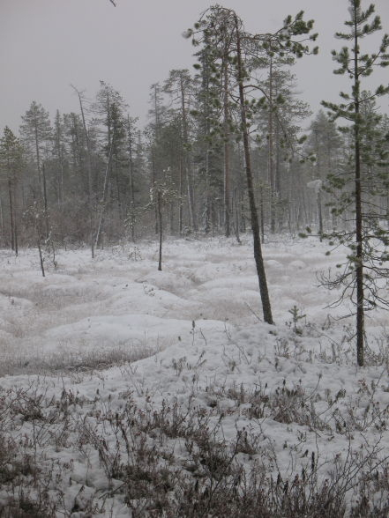
Program in nutshell
MH PWF in brief
LIFE projects of MH PWF
What is the LIFE programme?
LIFE characteristics
LIFE technical and financial issues – general conditions and typical pitfalls
Trouble tree, stakeholder analysis and logical framework as tool for project preparation
LIFE tools
Good quality LIFE proposal with eProposal
Projects and their management at MH PWF
Developing the project ideas with Logframe
Continuous and open discussion!

Slide 4
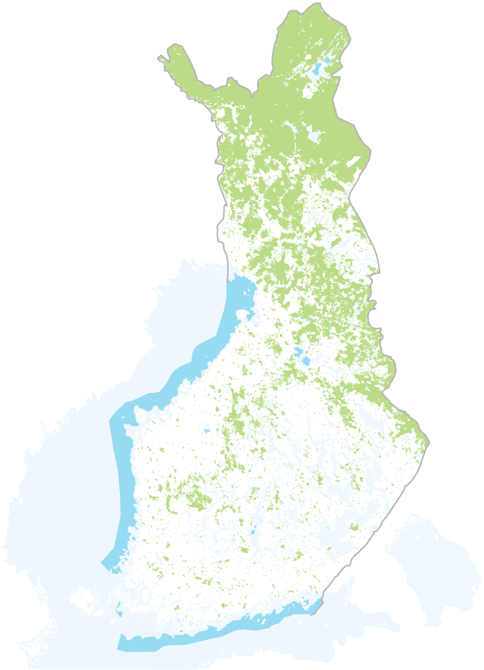
What is Metsähallitus?
A state enterprise governing all state-owned lands and waters.
business activities include a forestry company Metsähallitus Metsätalous Oy, seed production and selling of holiday plots and forest estates
public administration duties and
services are under Parks & Wildlife
Finland -unit
responsibility covers an area over 12 million hectares - one third of Finland´s total area
www.metsa.fi/web/en

Slide 5
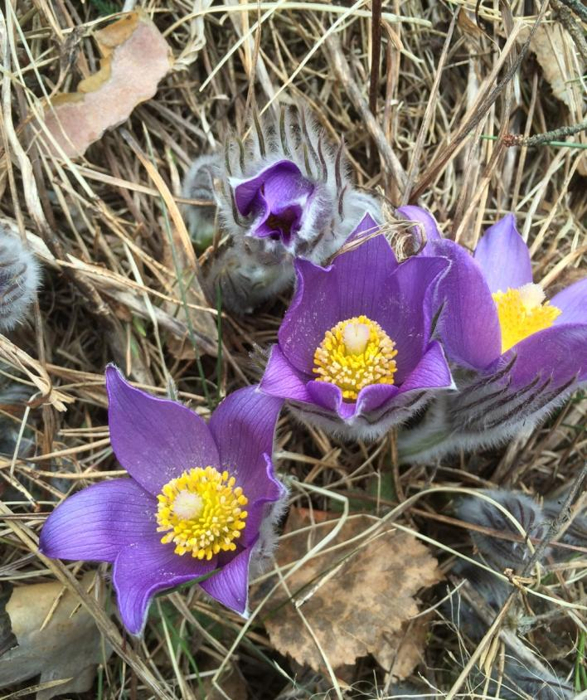
Parks & Wildlife Finland
Parks & Wildlife Finland (P&WF) is
a Metsähallitus unit responsible for public administration duties and services in
the fields of:
  nature conservation
  outdoor recreation
  management planning
  sustainable game and fisheries
Parks & Wildlife Finland:
  manages protected areas
  maintains outdoor recreation facilities free for public
  guarantees sustainable hunting and fishing including permit sales

Slide 6
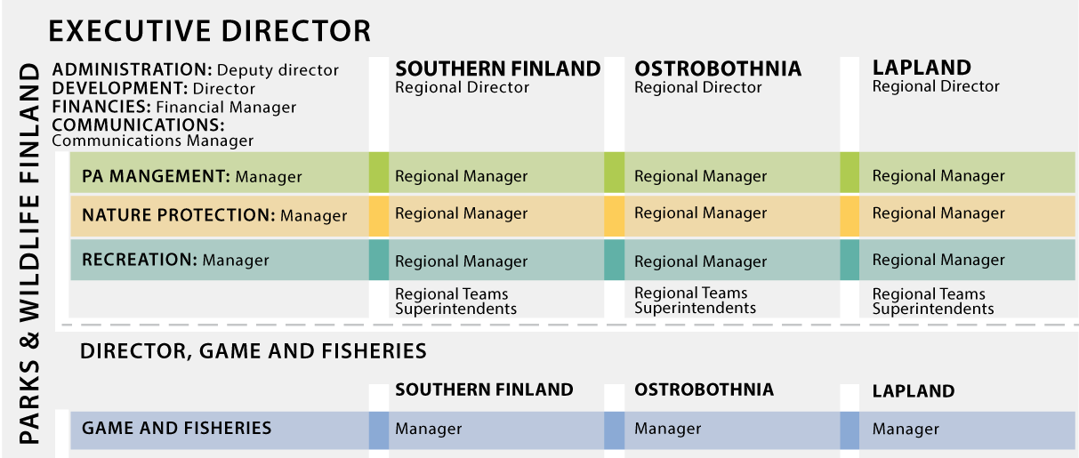
Organisation of Parks & Wildlife Finland

Slide 7
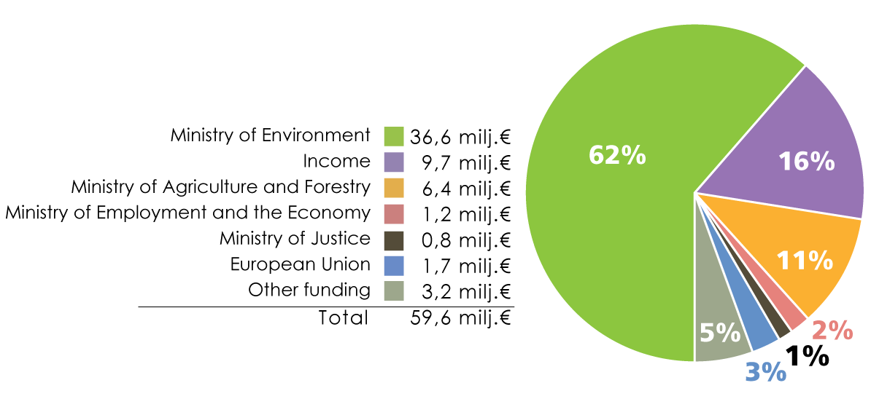
PWF´s finances in 2015
Projects
Clear increase in EU funding in 2016
P&WF´s activities are largely financed from the national government budget. Additional funding is obtained from EU programmes and fees paid for hunting and fishing permits.

Slide 8
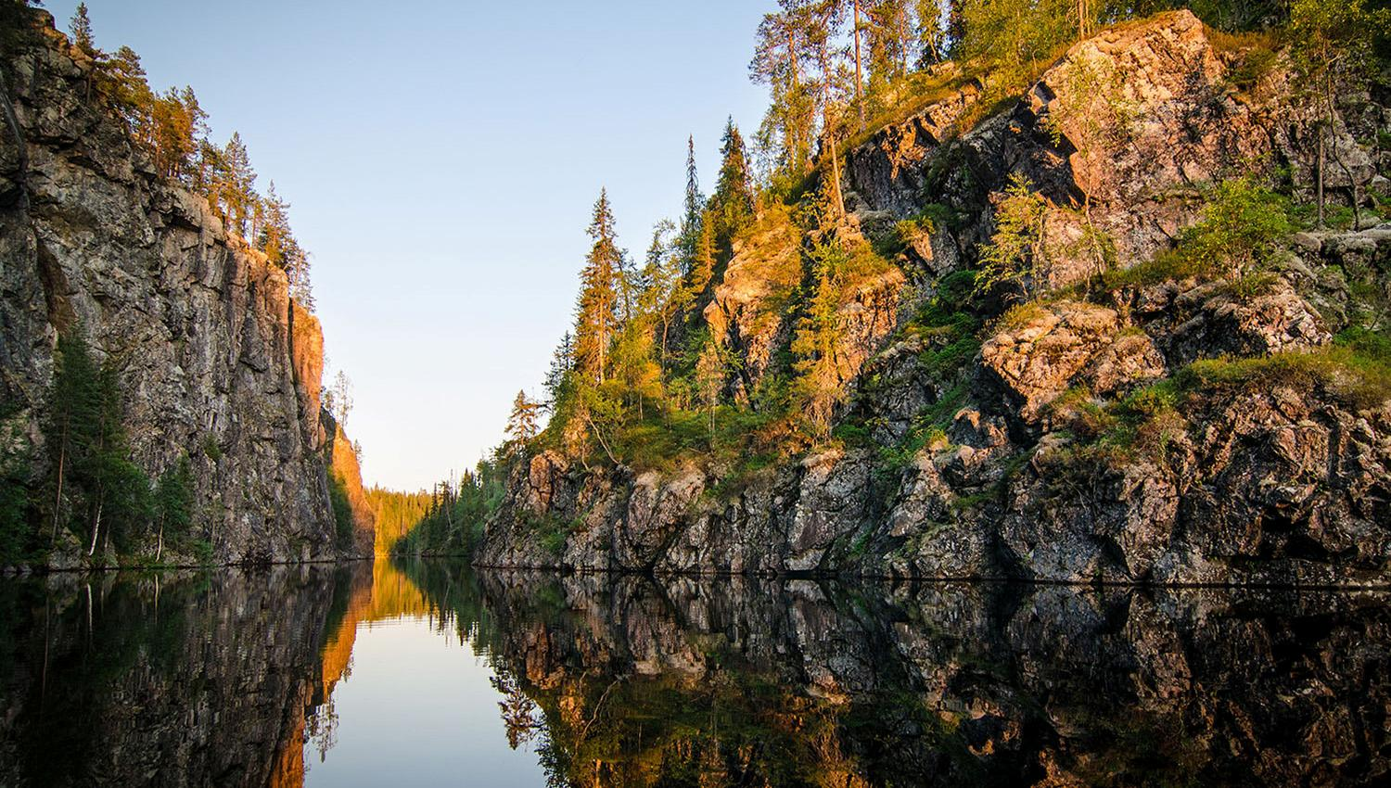

Slide 9


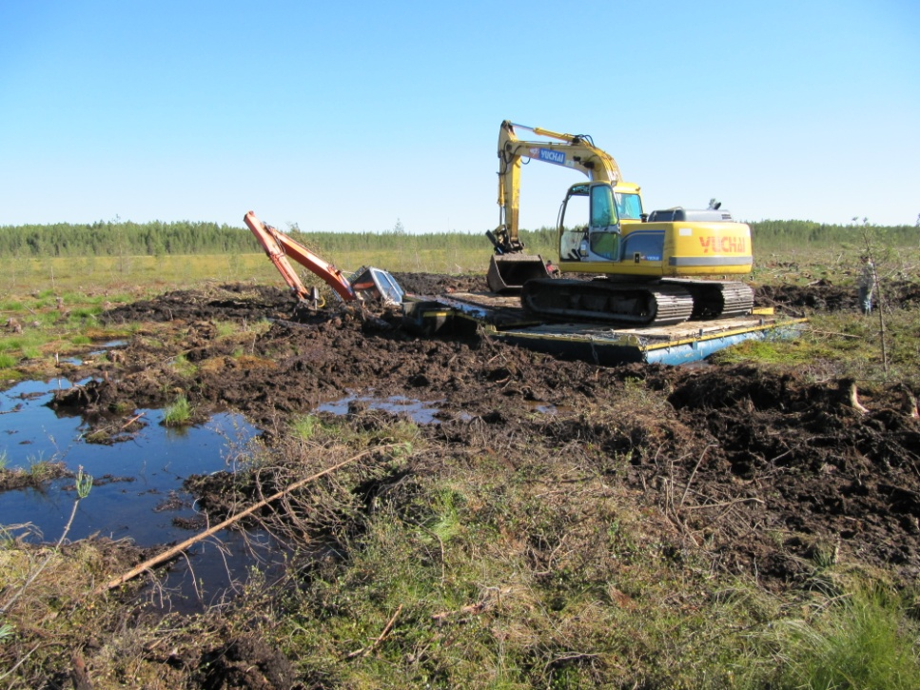
LIFE projects of MH PWF
Since 1995
In total 49 LIFE projects
  20 CoB (Nature 18, LIFE co-op 1, LIFE IP 1)
  29 AB (25 Nature, 2 Environment, 1 info and 1 BD)
Total budget 95 M€ (EU share 49,3 M€)
  Total MHLP 42,3 M€ (EU share 23,1 M€)
Mostly habitat related but also species projects
Currently involved in 10 LIFE projects (5 as CoB)
Typically 3-5 beneficiaries but also very large consortiums
  Regional environment and forestry authorities
  Universities
  Forestry companies (private and commercial)
  NGOs
  Municipalities and Ministries (co-financiers)

Slide 10
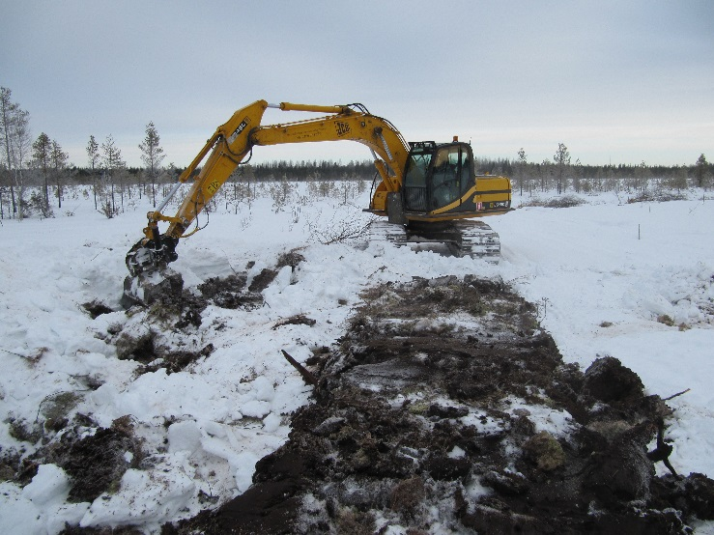

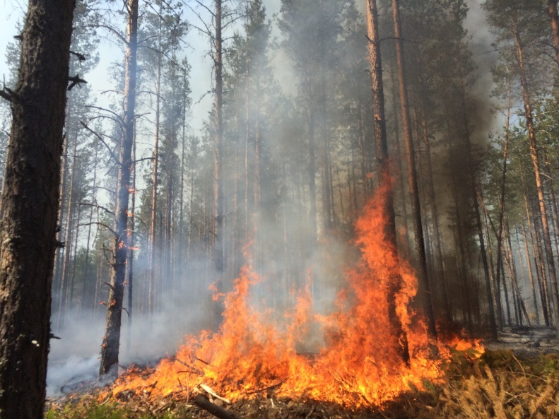
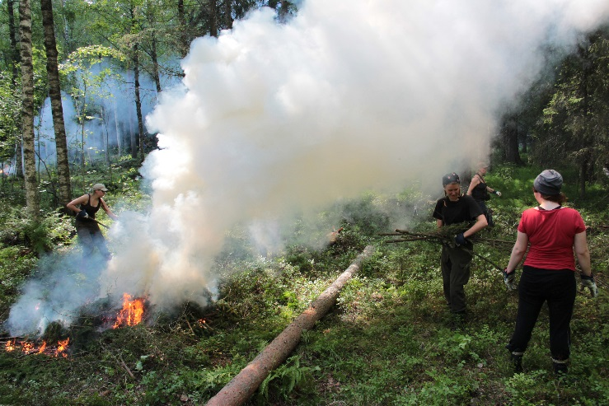


Habitat projects
  Peatlands (~20 + 1?)
  Boreal forests (~20)
  Wetlands (~10 + 1?)
  Seminatural grasslands (~ 10)
  Broad-leaved forests (~10)
  Eskers (sun exposed habitats) (~5)
  Sandy habitats (~3)
  Marine inventories (1)
  Sustainable use (ENV)
  From few sites to over 100 N2000 sites
  From regional to national
  Only 2 international

Slide 11
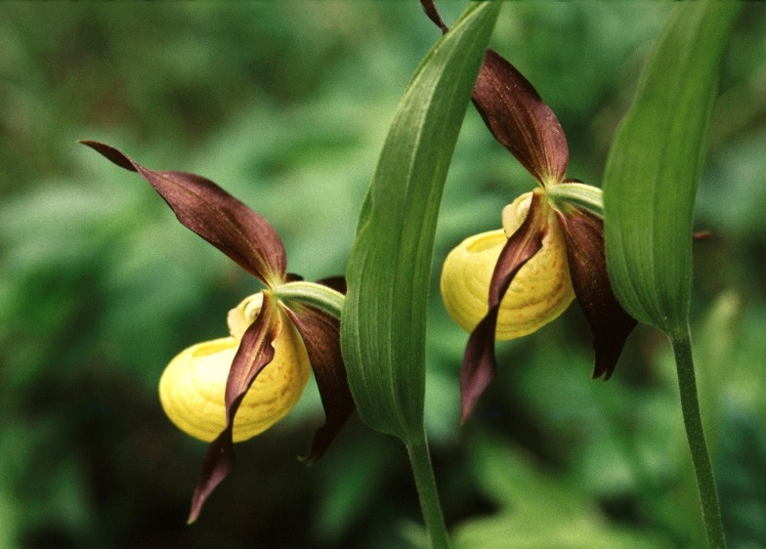
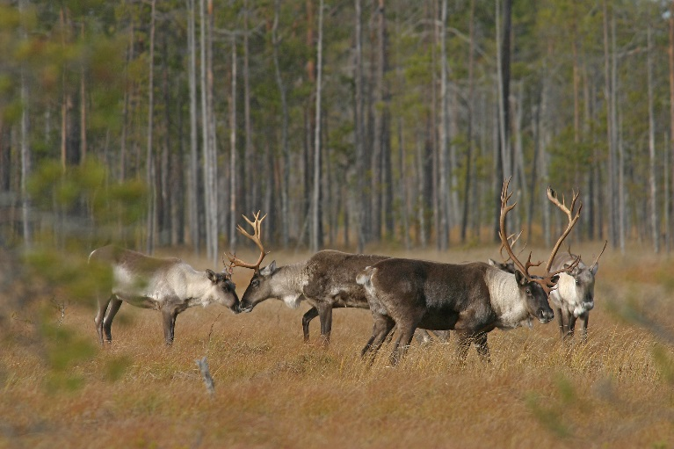
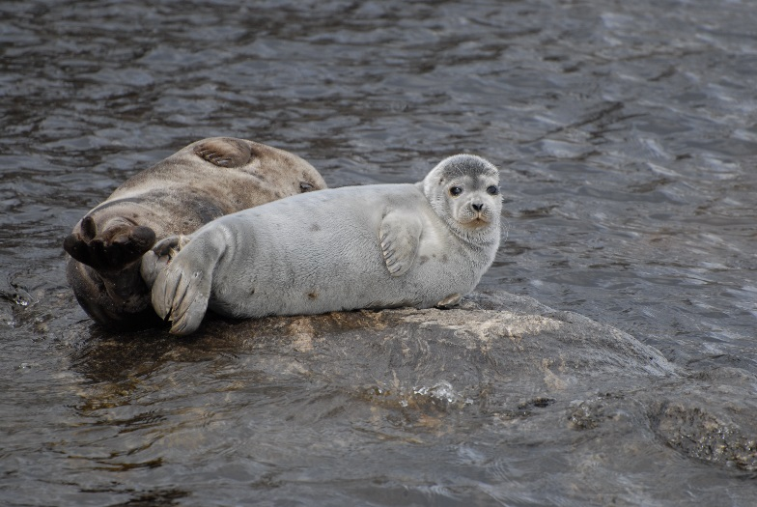

Species projects
  Lesser white-Fronted Goose (x3)
  Arctic fox (x2)
  Flying squirrel (1 + 1?)
  Wild forest reindeer (x2)
  Saimaa Ringed Seal (1)
  Cray fish
  Lady’s Slipper
  Beetles (1?)

Slide 12
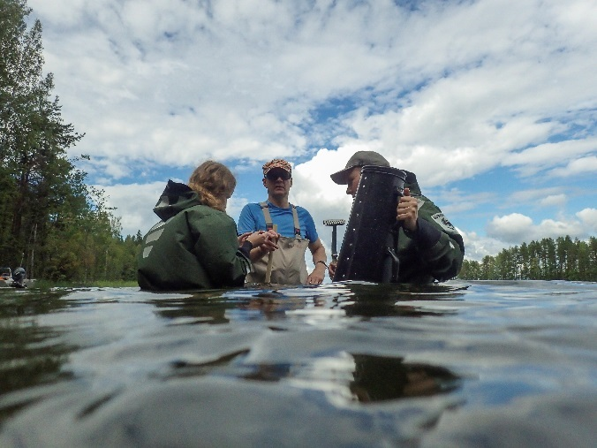
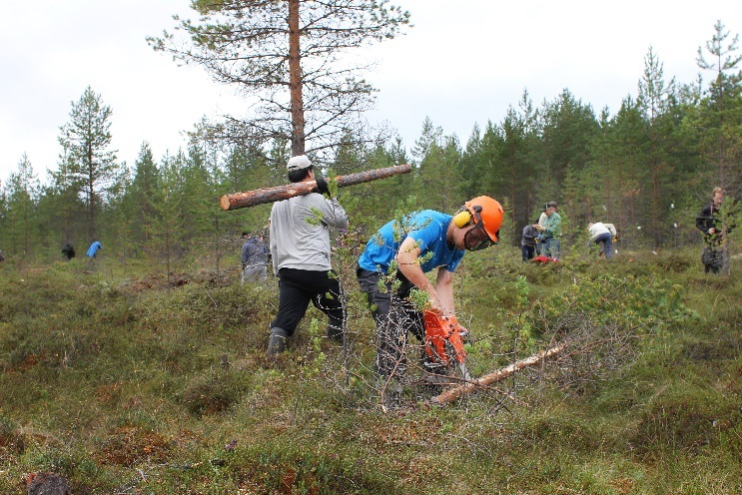

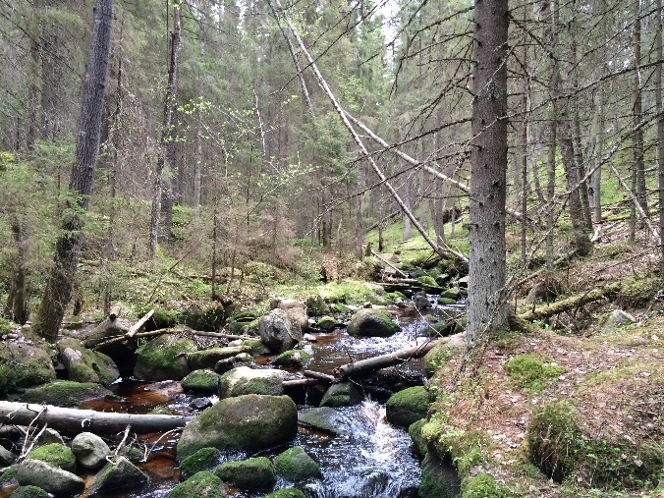
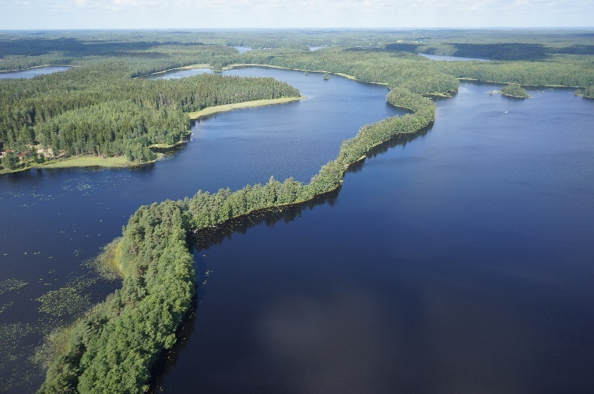
Integrated LIFE
FRESHABIT LIFE IP
Road map to implementing the PAF
LIFE as a catalyst

Slide 13
TYPICAL CONTENT
Planning; management and species actions plans and technical/restoration plans (approval of the plans, internal or ministry approval)
Supplementary inventories on habitats and species directly and indirectly affected included (lately also cultural heritage)
Restoration and management actions (implementing the restoration plans) – peatlands, forests, eskers, broad-leaved forests, meadows, alien species eradication, also recurring actions e.g. mowing for limited duration
Land purchase/lease (used as co-financing)
Dissemination (exhibitions, leaflets, DVDs, social media…)
Engaging volunteers (co-operation with NGOs especially on nature education, restoration camps, species protection task forces)
Media work (press, events, brochures, best practice guides, quite conservative… but)
Infrastructures; exhibitions, nature paths, observation platforms, toilets…
Monitoring actions (new and existing) and effectiveness (more focus on socio-economic)
Full time project manager, regional project managers and financial secretary

Slide 14

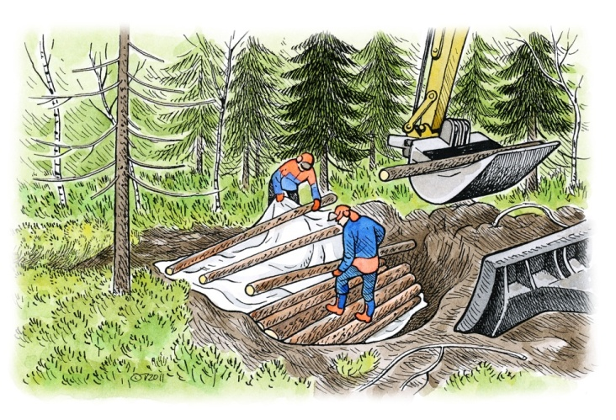
MAIN SUCCESSES
Broad variety of actions; focus on best practices
Geographical coverage and many habitat types targeted
Organisational structure; PWF works throughout Finland
Broad scope in beneficiaries (authorities – academia – NGOs – citizens)
Combining national objectives with LIFE
Increased cost awareness (financial tools for monitoring and planning)
Use of METSO (voluntary protection program) and VELMU (underwater inventory program)
Combining LIFE and rural development program (agr-env subsidies)
Development of best practices (habitat restoration)
For common people; voluntary work, participatory approach
Increased international co-operation
Experience in managing projects shared openly
Lately more focus on demonstration and innovation aspects

Slide 15

What is the LIFE Programme?
Dedicated solely to the implementation of the EU environmental policies

Slide 16
Components of LIFE
"Traditional" Projects”:
  LIFE Environment and Resource Efficiency (ENV)
  LIFE Nature and Biodiversity (NAT)
  LIFE Environmental Governance and Information (GIE)
  LIFE Climate Change Mitigation (CCM)
  LIFE Climate Change Adaptation (CCA)
  LIFE Climate Governance and Information (GIC)
Preparatory Projects
Integrated Projects (sub-programme for environment )
Technical Assistance Projects (sub-programme for environment )
Capacity Building Projects

Slide 17
LIFE ENVIRONMENT AND RESOURCE EFFICIENCY
Objective: Implementation, updating and development of various Community environmental policy and legislation
Actions related to Union policy on water, air, soil, urban environment, noise, chemicals, environment and health, waste and natural resources, forests
Focus: To bridge the gap between research and development results and widespread implementation, and to promote innovative solutions with a public dimension
Approach: Must be (EU wide) demonstration and/or pilot
Fulfilling at least one project topic (MAWP) and preferable included in the indicative list topics for application round

Slide 18
LIFE ENVIRONMENT AND RESOURCE EFFICIENCY
Linked to the following thematic priorities
Water, including the marine environment
Waste
Resource Efficiency, including soil and forests, and green and circular economy
Environment and Health, including chemicals and noise
Air quality and emissions, including urban environment
LIFE Environment proposals should NOT focus on:
Research and technological development activities
Studies not specifically addressing the objective aimed at by the proposal
Development of industrial capacity
Project focusing solely or largely to climate issues (LIFE CLIMA)

Slide 19
LIFE NATURE AND BIODIVERSITY
Nature
contributes to the implementation of the Birds and Habitats Directives (Council Directives 79/409 EEC and 92/43/EEC) –inside Natura 2000 network or contributing to its integrity
Biodiversity
contributes to the implementation of the objectives of the Biodiversity Strategy to 2020 including Natura 2000 - must address wild fauna/flora

Slide 20

LIFE NATURE
Contributes to the implementation of the Birds and Habitats Directives (Council Directives 79/409 EEC and 92/43/EEC)
Must be best practice and/or demonstration projects and/or pilot
Long-term sustainable investments in Natura 2000 sites and on the conservation of species and habitats targeted by the Birds and Habitats Directives (focus on ‘unfavourables’)
Must contain Concrete Conservation Actions (CCA) (at least 25% of the LIFE project's budget)
Must fulfill compeletely at least one (max two) project topics of MAWP
EU funding up to 75% (for priority habitats or species, solely)

Slide 21
LIFE BIODIVERSITY
Contributes to the implementation of the objectives of the Biodiversity Strategy to 2020
Best practice, demonstration or pilot (depending on the topic!)
The demonstration of measures and practices that contribute to halting the loss of biodiversity in the EU, other than those related to the implementation of the objectives of the Birds and Habitats Directives
Budget allocation minimum 25% for CCA
Proposals should focus on the project topics (MAWP); e.g. ecosystem services, green/blue infra, no-net-loss, alien invasive species
Compatible with national and/or regional strategies for biodiversity (if exists)
Proposals must address natural habitats and/or wild fauna/flora

Slide 22
LIFE Climate Action
  LIFE Climate Change Mitigation contributes to the reduction of greenhouse gas emissions
  LIFE Climate Change Adaptation supports efforts leading to increased resilience to climate change

Slide 23
LIFE Climate Action
  General objectives
  to contribute to the shift towards a resource-efficient, low- carbon and climate-resilient economy
  to improve the development, implementation and enforcement of Union climate policy and legislation
  to act as a catalyst for, and promote, the integration and mainstreaming of climate objectives into other Union policies and public and private sector practice;
  to support better climate governance at all levels, including better involvement of civil society, NGOs and local actors

Slide 24
LIFE Climate Action
  Specific objectives/ conditions:
  Improving and apply knowledge base in practice
  Develop and implement integrated strategies and action plans
  Develop and demonstrate innovative technologies, systems, methods and instruments for replication, transfer or instreaming, best practice
  Emphasising the synergies with other policies
  Small scale pilot, demonstration or best practice
  Linked to project topics (MAWP) and preferably to the priorities for the application round

Slide 25
LIFE GOVERNANCE AND INFORMATION
General objectives
to promote awareness raising on environmental matters, including generating public and stakeholder support of Union policy-making in the field of the environment, and to promote knowledge on sustainable development and new patterns for sustainable consumption
to support communication, management, and dissemination of information in the field of the environment, and to facilitate knowledge sharing on successful environmental solutions and practice, including by developing cooperation platforms among stakeholders and training;
to promote and contribute to more effective compliance with and enforcement of Union environmental legislation, in particular by promoting the development and dissemination of best practices and policy approaches
to promote better environmental governance by broadening stakeholder involvement, including NGOs, in consultation on and implementation of policy.

Slide 26
LIFE GOVERNANCE AND INFORMATION
Information and communication actions, awareness raising campaigns and skills development for implementing, updating and developing European environmental policy and legislation
Best practice sharing
Preferably related to the priorities set for the application round
Have to target a specific environmental problem
No need for demonstration or innovation

Slide 27
LIFE PROJECT CHARACTERISTICS
General issues common for all
LIFE NAT and BD specifics
Important administrative and financial conditions for proposal and the implementation
General advice
Problems/ pitfalls to avoid

Slide 28
LIFE PROJECT CHARACTERISTICS
Project period up to 10 years, but usually 5-7 years
No budget limitations but over 10M€ projects rare
Pure research actions not favored but OK if linked to the concrete actions or clearly justified for reaching the objectives
Ongoing actions not eligible if not clearly modified or justified that would be continued without LIFE funding
Sustainability of the results should be guaranteed and possible future funding convincingly explained
Complementary funding properly justified i.e. why LIFE and not other EU funds

Slide 29
LIFE PROJECT CHARACTERISTICS
Replicability and transferability should be included in the project and continue beyond the project period
Actions generally inside EU (exceptions apply in LIFE Nature and BD)
(True) international projects favoured

Slide 30
LIFE PROJECT CHARACTERISTICS
EU financing 60% (LIFE Nat max, 75%), Environment down to 50% from 2018 onwards
Indicative national allocations until 2017, after which merit only
Personnel cost, limitation for permanent staff of public bodies (2% rule)
External assistance max 35% if not properly justified
Durable goods, special depriciation rules apply (note the purchase date)

Slide 31
SPECIAL FEATURES OF LIFE NATURE AND BD
Recurring actions only limited duration (max 2/3 of the project duration)
    New recurring actions with demonstrative value OK
    Commitment for the continuity
Sustainability: commitment from private landowners (min. 20 years), sustainablity of the project results (usually clear inside N2000 areas)
Approval processes e.g. for management plans approved before the end date, new methods/recommendations adopted – relevant authorities supporting (form A8)

Slide 32
SPECIAL FEATURES OF LIFE NATURE AND BD
Land purchase for permanent protection OK if needed to reach the project objectives (check the checklist)
    Not possible between public bodies
    Necessary for the concrete actions
    Areas bordering targeted habitats/species occurrence sites
    Short term lease OK for demonstration/pilot actions
Actions for non SDF listed species/habitats not OK (unless MoE committed to supplement)
Species reintroduction possible (check the checklist)
    Feasibility (clear benefit, chance of suggest, financially viable, area under threat…)

Slide 33
SPECIAL FEATURES OF LIFE NATURE AND BD
Habitat actions outside N2000 possible in principle but
  Direct benefits to Natura to be proofed (e.g. coherence),
  Site actions also appropriate legal or contractual protection to quarantee sustainability
  Exception for infrastructures linked to migration corridors; guarantee of sustainability
  Note that for species actions explanation how guaranteed in long term is sufficient no obligation for legal protection

Slide 34
LIFE BASIC FINANCIAL AND ADMINISTRATIVE CONDITIONS
Large infrastructure (over 500 000€) not (usually) eligible
Overhead max. 7% on direct eligible costs excludind the land acquisition
VAT eligible if non-recoverable and not related to public authority actions, VAT certificate from tax authorities and public authority action justification from the beneficiary
Full-time project manager favoured; pay attention to the project management
Actions generally: preparatory, concrete, monitoring, dissemination and management
Few mandatory actions (monitoring indicators, socio-economic and ecosystem function assessment, audit and LIFE dissemination actions)

Slide 35
LIFE BASIC FINANCIAL AND ADMINISTRATIVE CONDITIONS
All based on
LIFE+ regulation
General conditions (Part A – Legal and Administrative Provisions Part B – Financial Provisions and Reporting)
Financial and administrative guidelines
Check the LIFE homepage: http://ec.europa.eu/environment/life/toolkit/pmtools/index.htm

Slide 36
LIFE BASIC FINANCIAL AND ADMINISTRATIVE CONDITIONS
Roles: Beneficiaries (CoB, AB), Co-financiers, Subcontractors
Beneficiaries (legal person) registered in EU; public bodies, private commercial and private not commercial (incl. NGO)
All beneficiaries contribute own financing and receive EU funding (at least 1 euro),
Arrange a proper project management (book keeping, personnel)
All beneficiaries jointly responsible
Ensure that all invoices and tendering documents bear reference to the project (code and name)
No service or product procurement between beneficiaries

Slide 37
LIFE BASIC FINANCIAL AND ADMINISTRATIVE CONDITIONS
Coordinating beneficiary
Signs the grant agreement
Concludes agreements with the associated beneficiaries describing their technical and financial participation in the project
It is granted a ‘mandate’ to represent all beneficiaries
Single Contact point for the Commission/Agency
Only participant reporting/establishing payment requests directly to the Commission/Agency
Ensures that payments are made to all partners (30 days after receiving payment from the Agency/Commission)

Slide 38
LIFE BASIC FINANCIAL AND ADMINISTRATIVE CONDITIONS
Associated beneficiary
Provide the coordinating beneficiary with all supporting documents necessary for technical and financial reporting – information needed to write reports, financial statements, etc. (regularly, preferably every 3 months…)
Inform the CB of any change that might affect project implementation
Inform the CB of any change in its legal, financial, organisational or ownership situation (usually requires modification of the grant agreement)

Slide 39
LIFE BASIC FINANCIAL AND ADMINISTRATIVE CONDITIONS
Co-financiers
Contribute financially to the project
Not involved in the implementation of project activities
Projects involving business-sector co-financing which contributes to the sustainability of project results – favourably considered during the evaluation process
Should not pay any invoices i.e. transfers euros for beneficiaries

Slide 40
LIFE BASIC FINANCIAL AND ADMINISTRATIVE CONDITIONS
Subcontractors
Provide external services to the beneficiaries and receive the corresponding full price
Best value for money taking also the quality into account
No financial investment in the project
Public tendering for public beneficiaries (follow the process in every detail); EU and national legislation + internal rules
Private beneficiaries: for purchase exceeding € 130 000: open tendering procedure
Details of the work in the invoices (tasks implemented and dates)

Slide 41
LIFE BASIC FINANCIAL AND ADMINISTRATIVE CONDITIONS
Subcontractors
Provide external services to the beneficiaries and receive the corresponding full price
Best value for money taking also the quality into account
No financial investment in the project
Public tendering for public beneficiaries (follow the process in every detail)
Private beneficiaries: for purchase exceeding € 130 000: open tendering procedure
Details of the work in the invoices (works and dates)

Slide 42
LIFE BASIC FINANCIAL AND ADMINISTRATIVE CONDITIONS
Technical and financial reports
Every 18 months according to the guidelines at LIFE page
Report includes technical and a concise financial report
    Comparison between realised and foreseen
    Cost per action
    Follow up of the time plan, deliverables and milestones
All reporting preferably in English
Financial sums by November for the Commission
Mid-term and final report including detailed financial report

Slide 43
LIFE BASIC FINANCIAL AND ADMINISTRATIVE CONDITIONS
Payments of the EU contribution
General rule max 80% as prepayments and 20% as balance
  1st pre-financing 30 % of contribution max. amount
2nd and 3rd pre-financing = max 20% each
Final payment = balance maximum 30%
After at least 100 % of 1st pre-financing has been used
Submitting the details re. auditor (Art. II.24.2)
Paid upon approval by the Agency/Commission of a request for payment and the technical progress report + statement of expenditure

Slide 44
LIFE BASIC FINANCIAL AND ADMINISTRATIVE CONDITIONS
Payments of the EU contribution
General rule max 80% as prepayments and 20% as balance
  1st pre-financing 30 % of contribution max. amount
2nd and 3rd pre-financing = max 20% each
Final payment = balance maximum 30%
After at least 100 % of 1st pre-financing has been used
Submitting the details re. auditor (Art. II.24.2)
Paid upon approval by the Agency/Commission of a request for payment and the technical progress report + statement of expenditure

Slide 45
LIFE BASIC FINANCIAL AND ADMINISTRATIVE CONDITIONS
Eligible costs
Provided for in the budget of the project or have been authorized (when required) through an amendment to the grant agreement
Directly linked to, and necessary for, carrying out the project
Reasonable and comply with the principles of sound financial management
Compliant with applicable tax and social legislation
Incurred and recorded in the beneficiaries accounts during the lifetime of the project (except cost related to request for payment of balance & audit)

Slide 46
LIFE BASIC FINANCIAL AND ADMINISTRATIVE CONDITIONS
Eligible costs
Indicated in the estimated budget and accepted by the Contracting Authority as necessary for project implementation
Costs are identifiable and verifiable (recorded in the accounting system)
They comply with the requirements of applicable tax and social legislation
They are reasonable and justified

Slide 47
LIFE BASIC FINANCIAL AND ADMINISTRATIVE CONDITIONS
Flexibility rules
Changes in provisional budget (transfer between or within cost categories) less than 20% of the overall estimated costs acceptable
Check the changes with the CoB and Monitoring Team/EASME beforehand
Costs inside budget category and between areas may be shifted between actions if targets are not jeopardised

Slide 48
LIFE BASIC FINANCIAL AND ADMINISTRATIVE CONDITIONS
Flexibility rules
Changes in provisional budget (transfer between or within cost categories) less than 20% of the overall estimated costs acceptable
Check the changes with the CoB and Monitoring Team/EASME beforehand
Costs inside budget category and between areas may be shifted between actions if targets are not jeopardised

Slide 49
LIFE BASIC FINANCIAL AND ADMINISTRATIVE CONDITIONS
Personnel costs
Related to employees salaries (direct personal cost - no external assistance)
Service contracts – under condition of working in the participant premises and under its supervision (timesheets needed)
Non-additional personnel salary costs: sum of public bodies’ contributions must exceed by at least 2 % the sum of public body employees who are not considered ‘additional’
‘Additional’ personnel includes permanent or temporary employees specifically seconded/assigned to the project or employees whose contracts start at the same time as the project

Slide 50
LIFE BASIC FINANCIAL AND ADMINISTRATIVE CONDITIONS
2% rule
Example of budget (sum of all public beneficiaries):
Personnel:
Non-additional staff 105 €
Additional staff 20 €
External Assistance 50 €
Equipment 25 €
Total 200 €
Life contribution = 50% (100 000€)
but
Minimum own contribution from public beneficiaries
= 105 € + 2 % = 107,10 €
Maximum Life contribution
= 92,90 €

Slide 51
LIFE BASIC FINANCIAL AND ADMINISTRATIVE CONDITIONS
Personnel costs
Principles
Supporting documents
Timesheets (regularly signed by worker and superior, digital signing OK)
Pay slips, annual salary documents, social charge documents , proofed by ledger books
Based on actual time
devoted to the project
Based on actual gross salary / wages + obligatory social charges
Comparison between proposal and realised

Slide 52
LIFE BASIC FINANCIAL AND ADMINISTRATIVE CONDITIONS
Travel costs
Principles
Supporting documents
Travel invoices with supporting documents
Journeys by car: based on distance and internal rules, logbook
Charged in accordance with internal rules of the beneficiary
Costs incurred by employees and volunteers (not by external consultants)
Not for journeys between home and work place

Slide 53
LIFE BASIC FINANCIAL AND ADMINISTRATIVE CONDITIONS
External assistance
Principles
Supporting documents
Follow applicable rules on tendering
Includes short term lease of land (expires prior to project end date, for Life NAT only)
Tendering documentation
Detailed invoices issued by the sub-contractor, with clear reference to the LIFE project and to the purchase order or the contract
Clear info and tasks provided and dates

Slide 54
LIFE BASIC FINANCIAL AND ADMINISTRATIVE CONDITIONS
Durable goods
  Charges relating to durable goods are eligible when the goods are :
    Placed on the beneficiary's inventory of durable goods
    Treated as capital expenditure
    Depriciated yearly
Depreciation of durable goods already owned by beneficiaries at the start of the project is not eligible for LIFE funding
Each beneficiary shall apply its internal accounting standard/rules to calculate the actual depreciation charges

Slide 55
LIFE BASIC FINANCIAL AND ADMINISTRATIVE CONDITIONS
Durable goods
  Charges relating to durable goods are eligible when the goods are :
    Placed on the beneficiary's inventory of durable goods
    Treated as capital expenditure
    Depriciated yearly
Depreciation of durable goods already owned by beneficiaries at the start of the project is not eligible for LIFE funding
Each beneficiary shall apply its internal accounting standard/rules to calculate the actual depreciation charges

Slide 56
LIFE BASIC FINANCIAL AND ADMINISTRATIVE CONDITIONS
Durable goods
Exception for LIFE NAT
Infrastructure, equipment :
    100% for public or non commercial beneficiaries
    depreciated for other beneficiaries (25% / 50%)
Reference to the project in the invoices (when possible, ask for new invoices)

Slide 57
LIFE BASIC FINANCIAL AND ADMINISTRATIVE CONDITIONS
Land acquistion
Land purchase, one-off compensation payment, land swaps (!)
Approved for foreseen areas in the proposal
Contracts (clause), parcel data, maps, area, taxes, costs, GIS data
Consumable material / other costs
Explicitly used for project purposes

Slide 58
LIFE BASIC FINANCIAL AND ADMINISTRATIVE CONDITIONS
Ineligible costs
Costs in any category of expenditure over and above that foreseen in the budget (budget transfers accepted in line with art II.22)
Recoverable VAT and VAT of public authorities (unless public authorities provide an official certificate stating that VAT cannot be recovered for costs related to the project, only relevant for non-authority measures)
Costs incurred in relation to activities not foreseen in the project
Costs incurred for the purchase of durable goods or communication material not bearing the LIFE logo (and the Natura 2000 logo, when applicable)

Slide 59
LIFE BASIC FINANCIAL AND ADMINISTRATIVE CONDITIONS
Ineligible costs
Costs incurred for an action which benefits from aid under other Union financial instruments
Costs related to any action considered as a compensatory measure
Costs related to management plans, action plans and similar plans, drafted or modified in the context of a LIFE project, if the related plan is not legally operational before the project end date
Exchange losses
Inkind contribution…. and many more….

Slide 60
GENERAL HINTS
Provide a clear, logical and coherent story; actions linked to objectives and related to clearly defined threats and problems
Check that you engage the correct beneficiaries for reaching objectives
Engage other beneficiaries at an early stage
Analyse also which stakeholders are important to reach and influence
Provide sufficient details for cost items
Pay attention to the coherence between technical and financial parts
Reserve enough time, invest in full-time project manager (if possible)
Read the guidelines and address issues included in the them!
Check the general conditions (rules of the game)

Slide 61
BASIC ACTION STRUCTURE AND HINTS FOR LIFE NAT
A –actions
  Preferably linked to C-actions
  Avoid data collection with no clear action to follow during the project
  Restoration/management plans… (additional inventories); permits
B-actions
  Purchase, one-off compensation (typical cases); land swap (note the timing of the transactions)
  Necessary for securing the conservation values
  Short term (project duration) compensation for demonstrating of pilots
  Provide statement on the market prices
C-actions
  Describe which habitats/species targeted (quantitative)
  Why infra/equipment/animals needed
What
Why
Who
When
Where

Slide 62
BASIC ACTION STRUCTURE AND HINTS FOR LIFE NAT
D-actions
How you monitor the effectiveness of the project actions on the conservation issues targeted
Assessment of the pilot and demonstration actions also with respect to replicability and transferability
LIFE performance indicators
Socio-economic and ecosystem function assessment!
E –actions
Define by target groups starting with general dissemination
Obligatory (www, info stands, Layman‘s report, After LIFE, networking)
Small scale infra limited to max 10% of CA budget
F-actions
  Table on the roles of the beneficiaries and management chart
  Action/description how reports are compiled
What
Why
Who
When
Where

Slide 63
PROBLEMS TO AVOID
Actions not linked to objectives
Actions vaguely described
Links between actions missing, no coherent story
Expected results not clearly measurable, lack of quantitave aspects
Actions have only limited outcomes; locally important but not at EU level
Sustainalibility not addressed
Consortium not right for solving the problem
Missing evidence on the effects of the actions
Monitoring not clearly linked to the actions and effect of the project

Slide 64
PROBLEMS TO AVOID
Dissemination and analysis of demonstration actions missing
Over ambitious both for actions and timetable
Project not related to the project topics or LIFE in general
Lack of commitment for permits, legal adoption of plans
Budget too vaguely described
Links between technical and financial part missing
25% rule concrete conservation measures not fulfilled
2% rule i.e. too much permanent staff

Slide 65
GENERAL TOOLS FOR PROJECT PLANNING
Logical framework
Problem tree
Stakeholder analysis

Slide 66
LOGICAL FRAMEWORK - LOGFRAME
Why?
Ensures that the project is logically structured
Defining linkages between the project and external factors
During implementation, the logframe serves as the main reference for drawing up detailed work plans, terms of reference, budgets, etc.
A logframe provides indicators against which the project progress and achievements can be assessed
It provides a shared methodology and terminology among governments, donor agencies, contractors and clients
Check e.g. http://www.sswm.info/content/logical-framework-approach

Slide 67
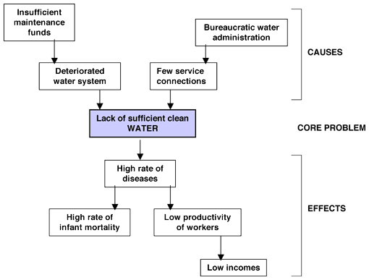
BEFORE LOGFRAME – PROBLEM(S) TREE

Slide 68
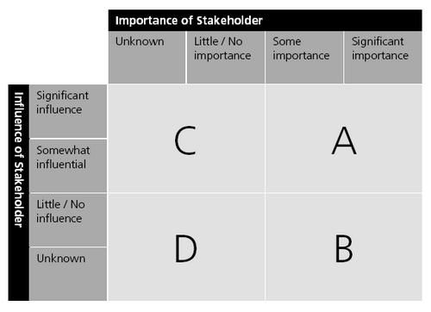
BEFORE LOGFRAME – STAKEHOLDER ANALYSIS
Box A Key stakeholders
high degree of influence on the project and high importance for the project success.
Box B Keep informed
high importance to the success of the project, but with low influence
require special initiatives if their interests are to be protected
Box C Keep satisfied
high influence, can affect the project outcomes, but whose interests are not necessarily aligned with the overall goals of the project
Box D Monitor
low influence on, or importance to the project objectives

Slide 69
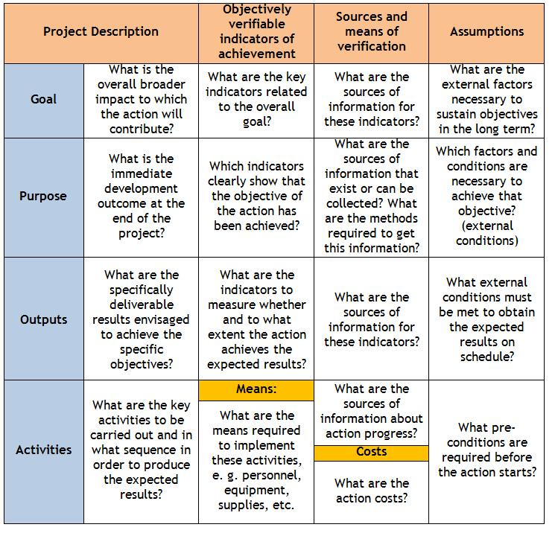
LOGFRAME
2
1.
Goal: overall objective that may be beyond the reach
Purpose: desired outcome the project will achieve
Outputs: Results of the project
Activities: Tasks needed to achieve these outputs. There may be several for each output.
Inputs: Means and costs, which are needed to carry out these activities.
3

Slide 70
LOGICAL FRAMEWORK – LIFE VERSION
See: separate doc-file

Slide 71
LIFE excel for budget
Info needed for each budget heading
General and Hydrology LIFE

Slide 72
eProposal

Slide 73
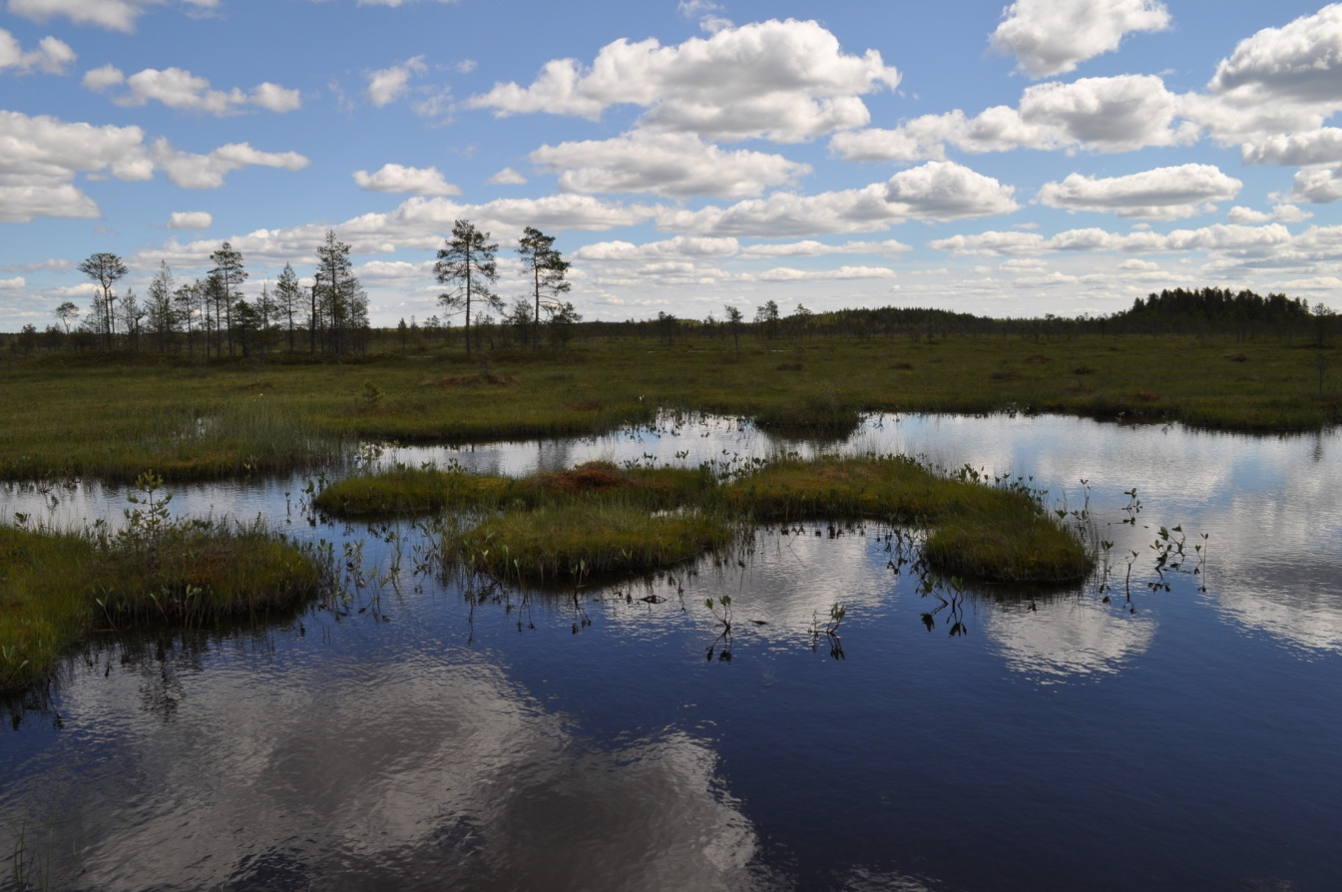
PROJECT ORGANISATION AT METSÄHALLITUS

Slide 74
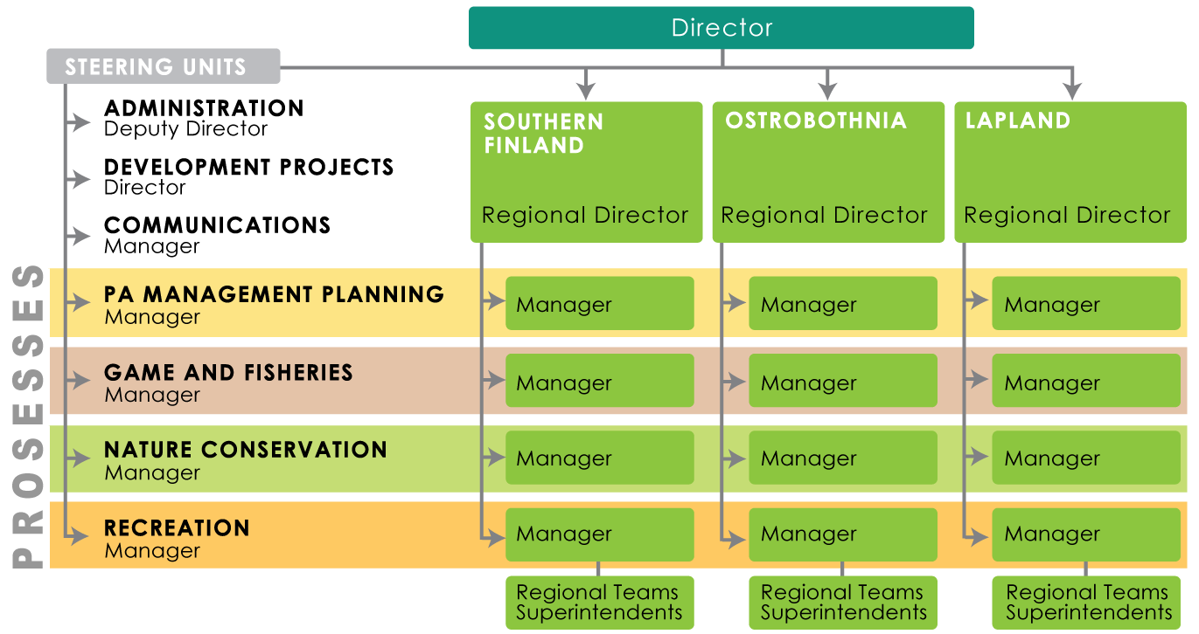
Organisation of the project management and development
All + included in tasks of selected staff + thematic groups + project development workshops, included in the yearl park action plans
Development managers for all regions
74

Slide 75
Organisation of the project work
Everybody can be active and spontaneus but also included in tasks + thematic groups + project development workshops
Project tools: documents (project description, final report)
    Links to the MH NHS strategy (strategy valid 2013 – 2020)
    Main outputs and results
    Timetable
    Organisation of the project
    Yearly budget (internal and external) and financing
    Risks
    Internal final report: Lessons learnt
Approved at regional boards, final approval by the board of PWF
Project management tools and assistance
  Project guide covering the project cycle from idea – to finalisation – new project
  Financial tools (separate financial tools especially for LIFE projects)
  Financial secretaries
75

Slide 76
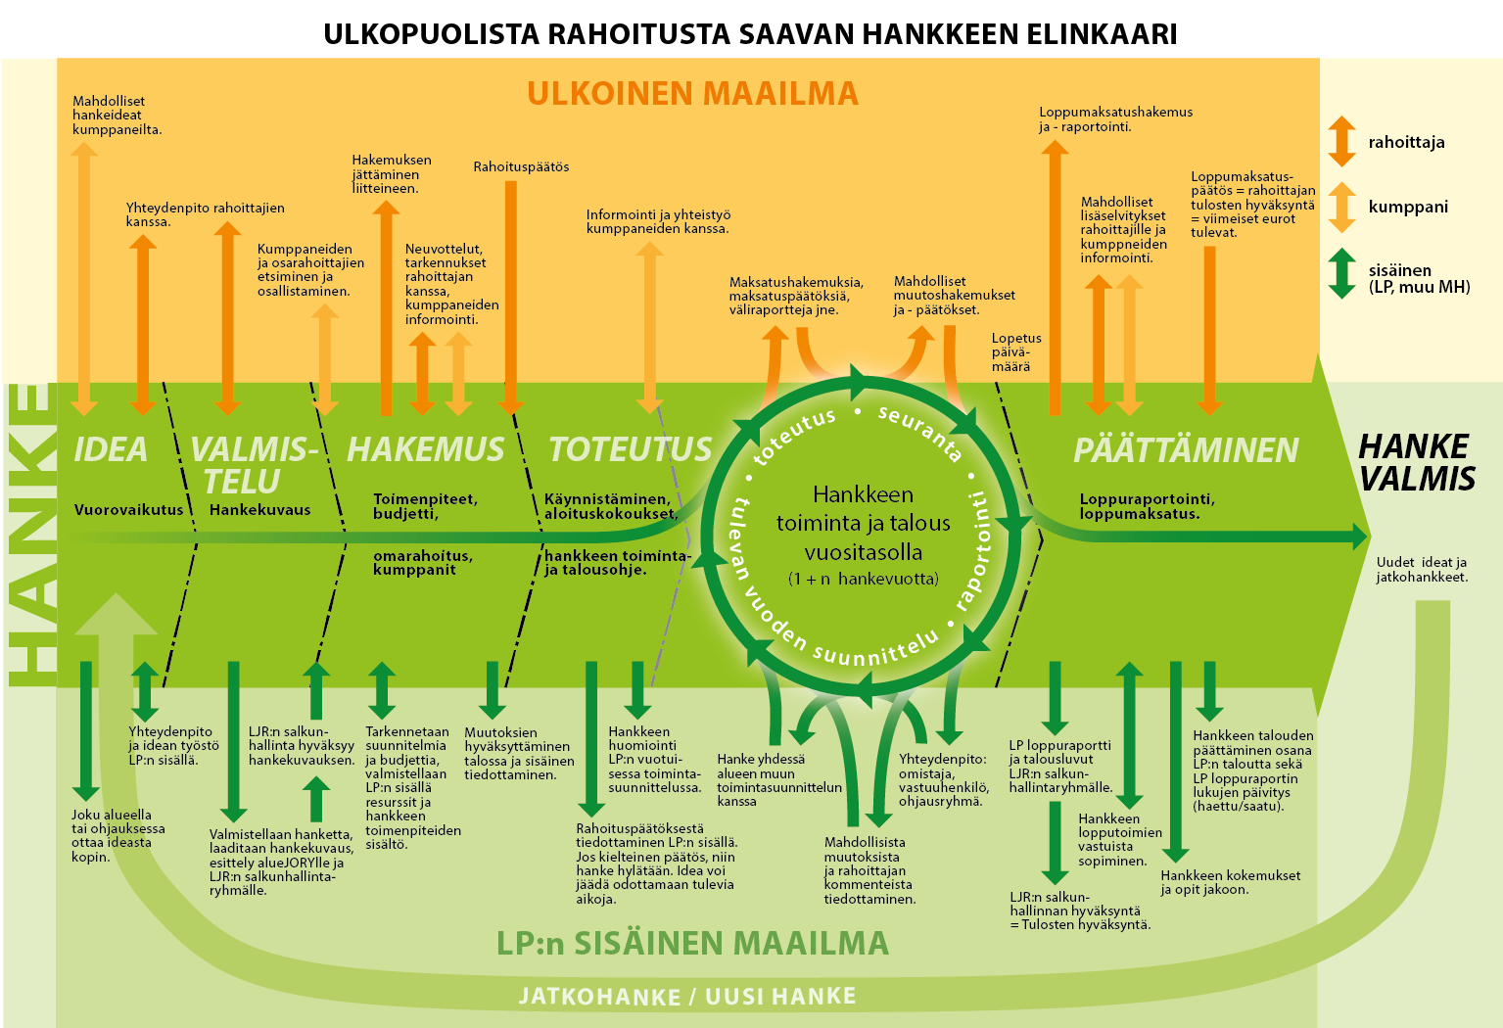

Slide 77
LIFE organisation
National level
  LIFE Nature working group with key beneficiaries
  Managed by the MoE (LIFE National Contact Point)
  1-2 meetings a year; experience and ideas
  Support for the project funding (and project proposal)
MH level
  Full time project manager for preparing proposal (at least for 6 months)
  Nature conservation core
  LIFE project team for each project (PM, LIFE expert and substance experts)
  Workshops for engaging all processes, other sectors of MH and other beneficiaries
  Project linked to core business, MH PWF CoB, in other AS

Slide 78
LIFE proposal- general issues
  Use logical framework - logical story, actions linked to objectives (or relevant strategy conservation plan)
  Project manager for each proposal
    Coordination of the proposal
    Partner meetings
    Majority of the writing
    No need for earlier LIFE experience required
  Other person for preparing the budget, consistency, LIFE budgeting tables
  Service unit for preparing maps
  Aim to have the full proposal ready 3 weeks before the DL – time for fine tuning
  Project analysis meeting app. 2-3 weeks before the DL
  More focus on transferability, replicability, uptake – capacity building

Slide 79
LIFE tools
LIFE financial management
Embedded in the financial management systems since 2010; careful coding and advising
Full time project secretaries (work effort always budgeted as direct cost)
All invoices checked and coded by expert, project manager, project secretary and approved by supervisor
LIFE timesheets embedded in time registry system
Yearly technical reporting from ABs – table format
Financial management meetings with ABs at the start of the project!!!
Link to financial tool
Link to simple technical reporting format
Link to time registry system

Slide 80
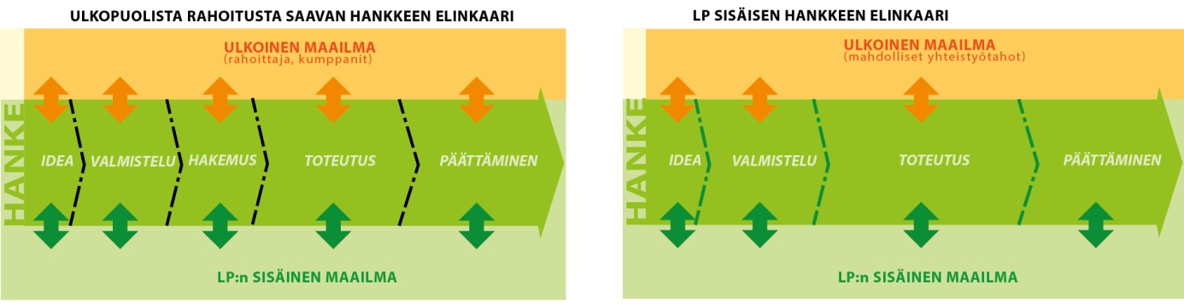
PROJECTS AT PARKS & WILDLIFE FINLAND
Project guidelines
The life cycle of the project
  Internal and external

Slide 82
PROJECTS AT PARKS & WILDLIFE FINLAND
Project guidelines – general key issues
Project as part of overall operation of MH PWF
Defined roles: owner, responsible person, project manager, project secretary (development team, financial team)
Short summary of key funding mechanisms
Vocabulary!
Sections: project planning and implementation

Slide 83
PROJECTS AT PARKS & WILDLIFE FINLAND
Planning the projects
Logframe with samples
instructions for the budget planning (e.g. personnel costs, VAT, indirect costs)
Communication inside MHPWF, with partners and with financiers
Communication actions in projects
Sample applications
Necessary annexes to the proposals e.g. VAT certificate, official signateurs, tax certificates

Slide 84
PROJECTS AT PARKS & WILDLIFE FINLAND
Implementing projects
Preparation of technical and financial guidelines for all projects (defined structure)
Financial management and monitoring – general principles and tools
Yearly technical and financial planning as part of MH operations
Internal and external opening meetings (defined agenda)
Public procurement with samples documents
Audit
Implementing communication
Data and document management
Sample reports

Slide 85
PROJECTS AT PARKS & WILDLIFE FINLAND
Currently app. 150 projects ongoing funded from several sources
Internal projects
  Nature conservation process changes to project based process
  Additional funding from state budget
  Also management plans and investments
External funding from various sources
Project types managed with project code series and funding program specific fundng codes

Slide 86
Funding sources
National | EU | Other
Employment and investment fund (until 2015) | LIFE (especially Nature) | Nordic Council of Ministers
Separate project funding from ministries (MoE, MAF, Min. Justice, Min. Education) | Structural and regional development funds (ERDF, Interreg) | Foundations (Metsämies, Aatos & Erkko)
Additional state funding | Social funds (ESF) | Sponsoring
Internal project funding | Neighborhood programs (ENPI + ENI) | Not yet realised…
Municipalities (co-financing) | Rural development program (regional level)
 | Horizon 2020 (as partner or target)
 | Erasmus (as partner)

Slide 87
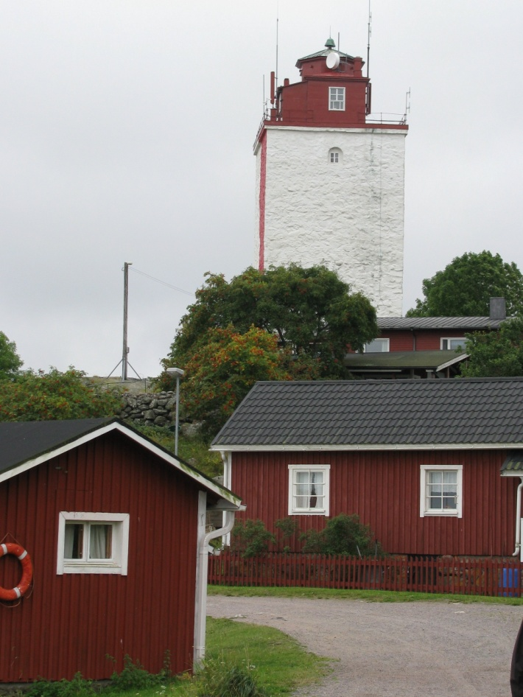
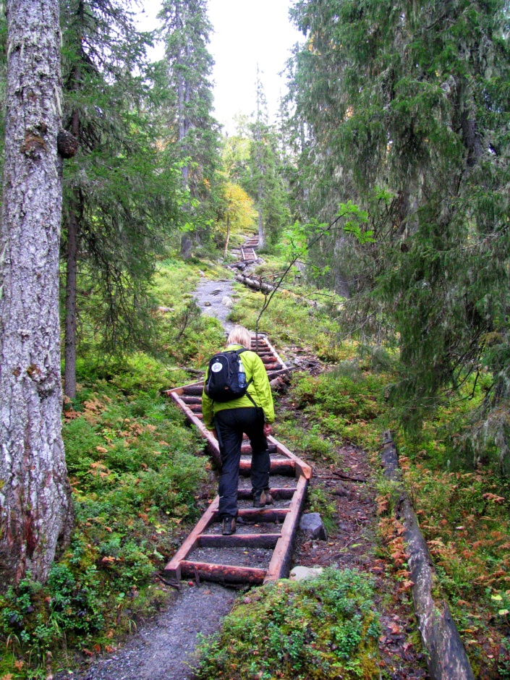
EU – Regional and rural development
ERDF: Mostly local projects linked to nature tourism (planning, preconditions, exhibitions); now green solutions, low carbon, digitalisation, local business development)
Rural development: nature tourism linked to local entrepreneurship, GreenCare
Interreg: Joint development projects with EU neighbours on common themes (sustainable nature tourism, Baltic Sea)

Slide 88
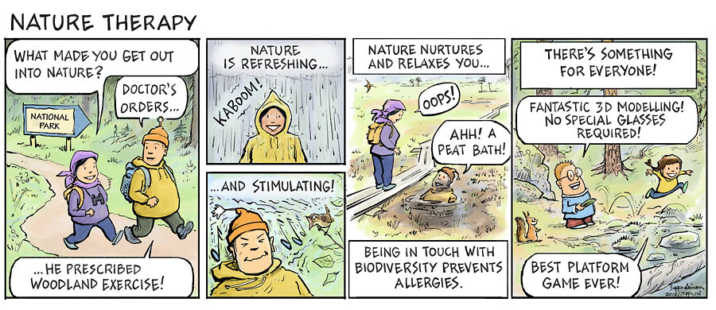
EU – Social funds
Nature for health and well-being
Immigrants
Social exlusion
Role of nature, new concepts
new partners

Slide 89
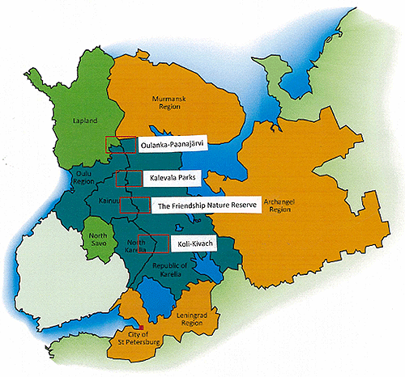
EU – Neighborhood programs (ENPI + new ENI)
Co-operation with Russia
Crossborder
Sustainable use and biodiversity included in all three programs
Focuses on
  Capacity building, visibility
  Investments
  Nature and cultural tourism
  Nature conservation

Slide 90
National | EU | Other
Employment and investment fund (until 2015) | LIFE (especially Nature) | Nordic Council of Ministers
Separate project funding from ministries (MoE, MAF, Min. Justice, Min. Education) | Structural and regional development funds (ERDF, Interreg) | Foundations (Metsämies, Aatos & Erkko)
Additional state funding | Social funds (ESF) | Sponsoring
Internal project funding | Neighborhood programs (ENPI + ENI) | Not yet realised…
Municipalities | Rural development program (EAFRD)
 | Horizon 2020 (as partner or target)
 | Erasmus (as partner)

