Slide 1


The LIFE Programme
Tips and pitfalls
Katrin Ritso
Monitoring Expert (Neemo EEIG – ELLE)
LIFE Info Day
Estonia
4 May, 2020

Slide 2

The External Monitoring Team

Slide 3
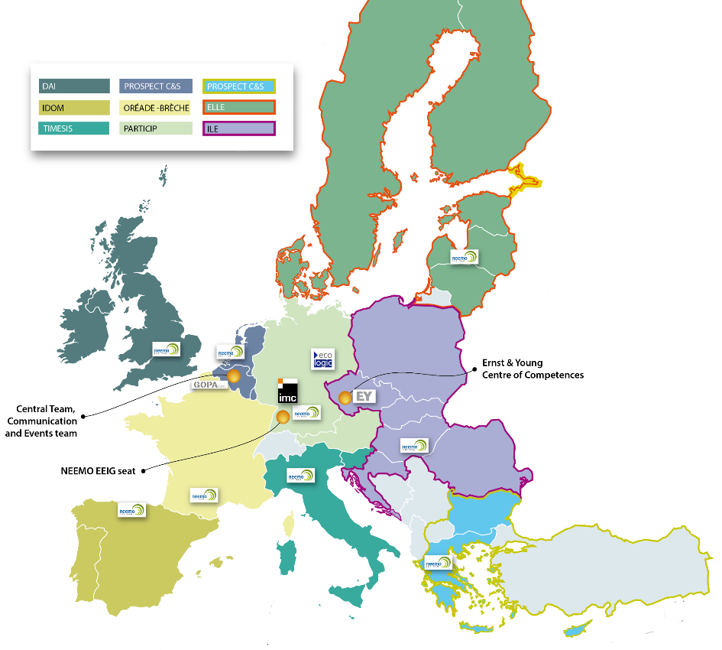

Slide 4
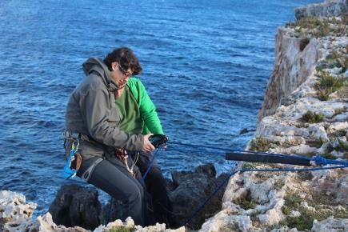
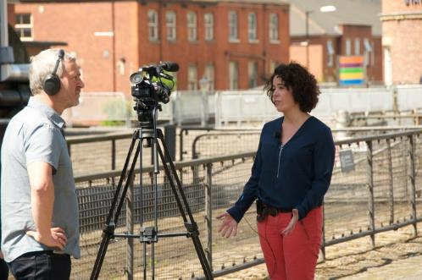
Main Activities
Monitoring of projects supported by the LIFE Programme:
      Checking the compliance with LIFE rules – administrative, financial, communication
        Checking the project technical progress –monitoring missions
        Policy impact/relevance – through DeNTE Hubs
        C2M follow-up and coaching
Notes:
Märgi jutus ära ainult 2 esimest

Slide 5
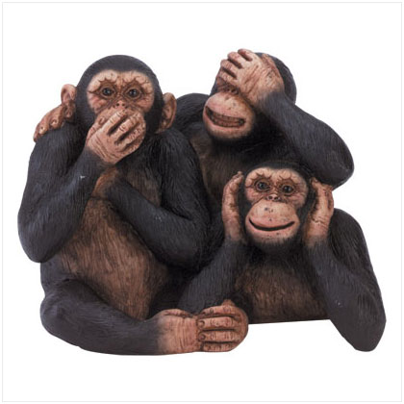
article II 1.4
Notes:
NEEMO only gives opinion/advice, cannot make any decisions on behalf of the EC!

Slide 6
The LIFE Programme
2014-2020

Slide 7




LIFE's overall objective
To contribute to: the implementation, update and development
of the EU environmental and climate policy and legislation
L’Instrument Financier pour l’Environnement
Notes:
LIFE programm on ellu kutsutud, et panustada ELi keskkonna- ja kliimapoliitika ning õigusaktide rakendamisse, ajakohastamisse ja arendamisse.

Slide 8
LIFE 2014-2020 – Objectives
Contributing towards a resource-efficient, low-carbon and
climate-resilient economy; protecting and improving the environment; maintaining and improving biodiversity, ecosystems and, in particular,
the Natura 2000 network
Improving the development, implementation and enforcement of
Union environmental and climate policy and legislation
Integrating and mainstreaming of environmental and climate objectives
into other Union policies
Improving environmental and climate governance
Implementing the 7th Environment Action Programme
Notes:
LIFE programmi peamised eesmärgid on:

Slide 9
LIFE 2014-2020: Priority Areas & Budget

Slide 10
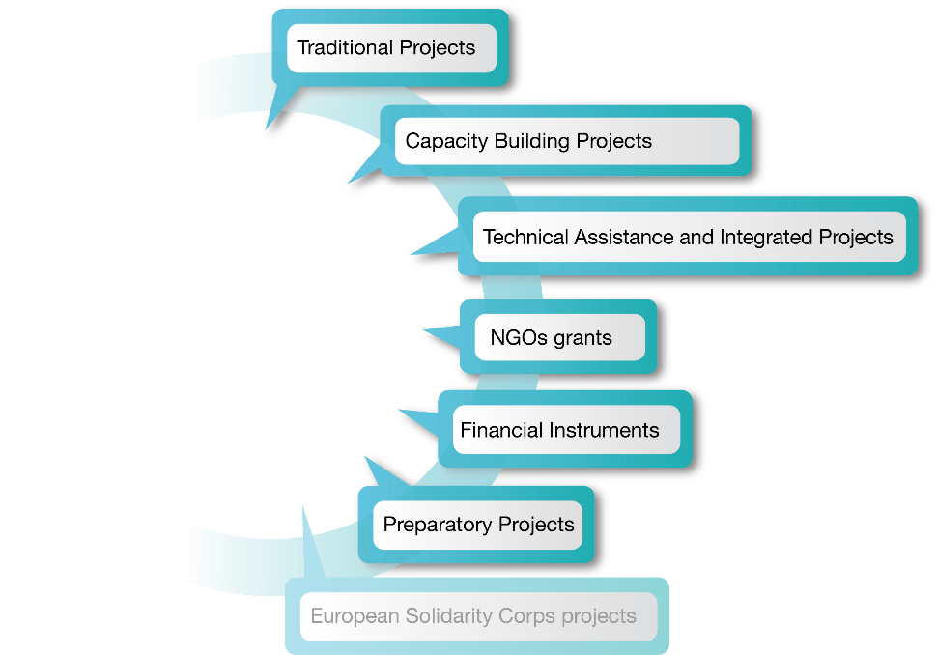
What is LIFE financing?
Notes:
ESC projects - no specific LIFE ESC Calls since 2017
2019 Call puts additional emphasis on, inter alia, response to environmental and climate challenges, including disaster prevention, preparedness and recovery (excluding immediate disaster response).
For further information:
https://europa.eu/youth/solidarity/organisation_info_en
https://ec.europa.eu/youth/annual-work-programmes_en

Slide 11
LIFE – General features
  Applicants - Companies, research institutes, NGOs, public administrations active in the field of environment and climate protection; all legal persons registered in the EU
  Emphasis on replicability/transferability, long-term sustainability,
  and an EU added value of the project results
  Not focused on research (➠H2020)
  No large infrastructure; not focused on rural or regional development
  (➠ agricultural, structural funds)
  Support and monitoring: from Contracting Authority
  (EASME or European Commission) and
  external monitoring team
Notes:
Some research activities can be planned within preparatory actions
Some infrastructure can be financed mostly for NAT projects (e.g. walking paths in a protected area, fencing to protect species, etc.)

Slide 12
LIFE 2014-2020 – Important documents
The LIFE Regulation (EU Regulation 1293/2013 of 20/12/2013)
The LIFE Multiannual Work Programme 2018-2020 (Commission Implementing Decision (EU) 2018/210 dated of 12/02/2018)
The Action/Operating grant agreements of beneficiaries with
the Contracting Authority (including General Conditions)
or agreements of recipients with banks
Notes:
The second Multiannual Work Programme (MAWP 2018-2020) is stable for 3 years to ensure stability in both the selection/award criteria and also in the project topics for traditional projects under the environment sub-programme.
This is essential reading for anyone thinking of submitting a project!

Slide 13
Important highlights for
the LIFE Call 2020

Slide 14
LIFE 2020 – Indicative planning and Budget

Slide 15
Covid19 related Flexibility measures
All deadlines extended by one month
Increased first pre-financing payment
Grants to third parties
New narrative on start-ups
Private entities: no obligatory tendering above 139K€
Increased flexibility for 2% rule
Priorities and topics remain, but ideas connected with pandemics management welcome
Dulcis in fundo: one to one bilateral chats with all those who need counselling on their proposals
Notes:
Seoses Koroona viiruse levikuga rakendatavad paindlikkuse meetmed.
Grants to third parties - LIFE projects may budget financial support to third parties in order to assist entities outside the project partnership (e.g. non-profit organisations, local authorities or citizens groups) in the implementation or development of local initiatives that will contribute to the project’s objectives. Max 100K€ (200K€ for IPs) per project and 20K€ per initiative.
Support to start-ups - The LIFE programme favours innovation and commercialisation introduced by dynamic start-ups and the LIFE project could represent, in this sense,
a risk-free incubation context that allows the start-up to safely bring its solution to the market, supported by appropriate financial, technical, business means and expertise. In this context, the LIFE programme welcomes proposals whose partnership combines the knowledge and expertise of consolidated market players with
the drive of start-ups which want to commercialise their solution.

Slide 16
Few tips

Slide 17
Be Aware
It takes TIME to read the application guidelines:
  Verify that LIFE is the appropriate funding programme for you
Be AWARE of all the exceptions that may apply to you
Financial coherence is a key issue , check systematically COST EFFECTIVENESS
Avoid to include actions not related to the objective of your proposal
Remember the up extra points bonus you will get if your project fits the
priority project topics
The SELECTION procedure will definitely consider these elements
when evaluating your proposal

Slide 18
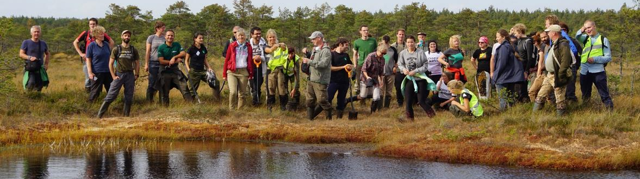
Think about Thematic Platform meetings or Conference
If your future project has a great policy feedback potential, think to include resources to host a large conference or a LIFE Thematic Platform meeting.

Slide 19
Project Budget
Only costs incurred for actions implemented during project life-time
can be eligible!
Personnel – 2% rule for public bodies (own contribution from public bodies and public third party co-financers should at least be 102% of non-additional staff costs)
Daily rate – based on gross salary + contributions according
to the national legislation (social security, pension, etc.)
Travel costs – according to internal rules of project beneficiaries
External assistance – not more than 35% of the total budget
Public entities must comply with public procurement rules
Good value for money and no conflict of interest when selecting suppliers

Slide 20
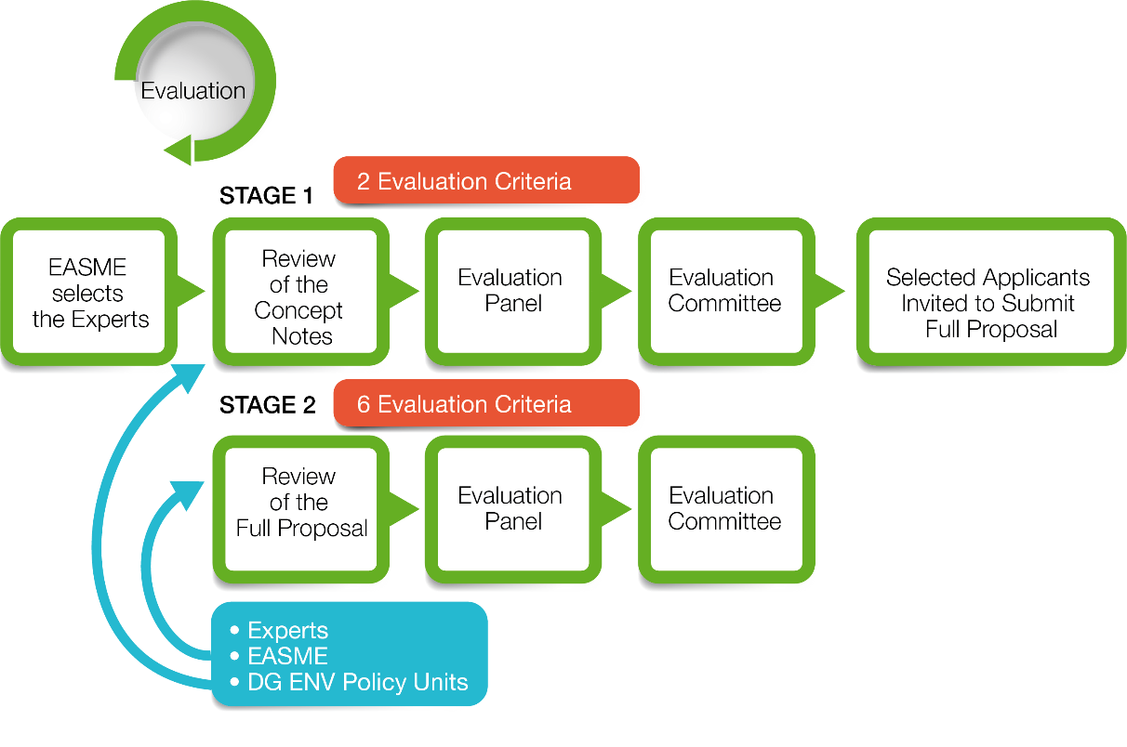
Sub-Programme Environment
Notes:
Keskkonna alamprogrammis (kuhu alla kuuluvad Environment & Resource Efficiency (ENV), Nature & Biodiversity (NAT, BIO), Environmental Governance & Information (GIE) projektid) toimub projektitoatluse esitamine läbi 2-etapilise taotlemise.
I etapis esitatakse kuni 10-leheküljeline projekti kontseptsioon (Concept Note) läbi eProposal keskkonna.
Projekti kontseptsiooni hinnatakse 2 kriteeriumi alusel:
Üleüldine taotluse kvaliteet
Üldine lisandväärtus EL tasandil (panustamine LIFE prioriteetidesse, oodatav mõju, tulemuste jätkusuutlikkus)
Parimad projekti ideed kutsutakse esitama täiemahulist taotlust (Full Proposal) eProposal keskkonnas, kus on juba olemas kontseptsiooni esitamise etapis sisestatud info.
Täistaotlust hinnatakse 6 kriteeriumi alusel:
Tehniline selgus ja kvaliteet
Finantsiline selgus ja kvaliteet
Panustamine spetsiifilisse LIFE Keskkonna alamprogrammi priotiteetsesse eesmärki
Jätkusuutlikkus (jätkamine, ümberpaigutamine, ülekandmine)
Panustamine projekti teemadesse
Sünergia ja rahvusvahelisus

Slide 21

Be aware – at the evaluation stage the concept note must fulfil the same elibility criteria than those of the full proposal
Notes:
Changes can be introduced to the application including for the budget as long as the total EU contribution does not increase by more than 10%.
Be careful to mention that the changes that are made to the application should not question the rationale for the selection of the CN in term of objectives and results to be expected.

Slide 22

The applicants with the best ranked concept notes will be invited (in 10/2020) to submit a full proposal using the web tool eProposal available via the LIFE web page.

Slide 23
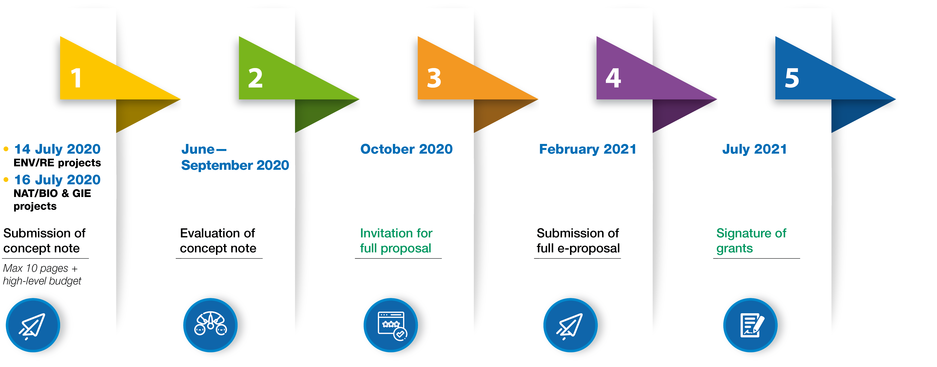
Indicative Timetable :
Application Environment Sub-Programme

Slide 24
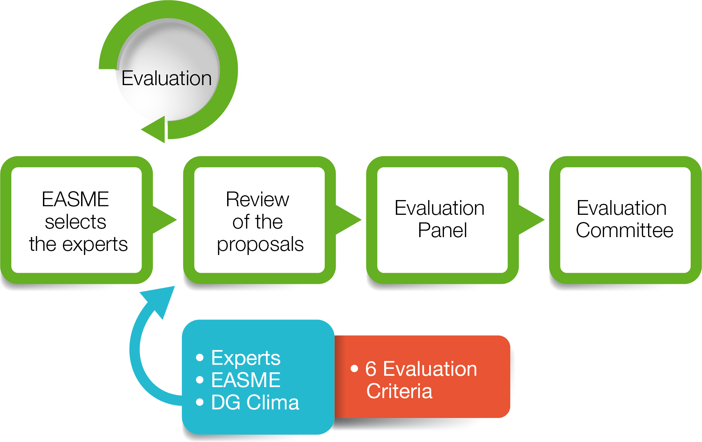
Sub-Programme Climate Action – One stage
Notes:
Kliima alamprogrammis (kuhu alla kuuluvad Climate Change Mitigation (CCM), Climate Change Adaptation (CCA), Climate Change Governance & Information (GIC) projektid) toimub taotlemine ühes etapis, kus kohe esitatakse täis taotlus.

Slide 25
Evaluation of LIFE proposals:
Common Pitfalls

Slide 26

The baseline is incomplete
What is the problem you want to address
What are the challenges in your specific context
What has been done so far – value added of the project
Baseline data (surveys, results of tests, etc.) → provide the data source and, when relevant, maps
Notes:
Baseline is key → if not well described, then link actions- objectives may be weak
Need to understand what is the situation before the project → need to be comprehensive and clear → only evaluate based on the text in the project
What is the problem you want to address → clarify why there is this problem – solution for floods management
don't write general statements on climate or environment but be specific
Don’t write that there is not well planned investment in renewable energy → need to explain why: the law is not in place, not enforced, weak stakeholders participation, little knowledge of decision makers, no tools to plan and identify impact on biodiversity etc.
If you state that there is a lack of knowledge or little investments on renewable energy, then you need to provide data and sources → surveys
Baseline can be completed in preparatory actions
What has been done so far – value added of the project
If you propose a new solution, please define what is the state of art on the market
If you propose trainings, explain how you intend to update/upgrade the existing ones – how they will be used?
if you propose a pilot, demonstrate that this is a new solution
Check LIFE website – current initiatives –build up additional point on EU research projects
Baseline data (surveys, results of tests etc) → provide the sources of your data and, when relevant, maps

Slide 27

Target group, stakeholders, partnership not appropriate
Who is affected by the problem ? Who will use the solutions/tools developed ?
Local authorities involved ? How ? Ensure active participation of key stakeholders
Partnership based on expertise needed in the project
Notes:
Target group is the primary group that will benefit from the project – there is expected change in this group, in terms of behaviour, policy making, consumption, production
Improve the waste management in your area → target group cannot be students, you need to involve the right stakeholders
Stakeholders – need to identify the most important ones – if you develop a new waste heat recovery for a glass industry, need to ensure that policy makers are involved → uptake the solution at policy level – work on curricula in schools to include environmental education → permits Min Education
Partnership - Development of fossil free cement → production plant needs to be in the partnership to ensure production, scale up

Slide 28

Unclear link between actions and objectives
Are the actions appropriate to address the problem identified ? Use logical framework
Clearly present who does what and when
Tools/strategies/methodologies → needed for concrete implementation
Transnational?
Notes:
Sometimes it’s not clear why some activities are needed. Development of green infrastructure – workshops with farmers on biodiversity conservation
From the problem identified, we need to see actions that clearly address the problem – state you want to improve the increase awareness on N2000 in a specific area – expecting communication and/or capacity building actions. Developing a tool (mobile App) is not sufficient
How do you address the problem identified? The threats on species?
Unclear link among the activities
Development of a tool – project cannot finish there but needs to start there – who will use the tool? Climate planning municipalities. Specific GIE/GIC
Transnational only if relevant not window dressing – in case, up to 3 points

Slide 29

Sustainability not ensured
Technical sustainability should be built in the project ex. scale up pilot, uptake of policy recommendations / tools
Responsibilities – who will do the job afterwards ?
Who will use the tool / products developed ?
Financial sustainability
Notes:
Develop a new low emission refrigerant for air conditioning – pilot – promise to scale up
You have a solution to reduce emission in combustion of silicon – how will that solution be taken/used by the policy makers
Responsibility – monitor a species reintroduction – who will do afterwards
Coordination platforms, application smart – who will use afterwards

Slide 30

Low impact/little EU added value
What are the changes achieved?
Value for the EU: policy update, new legislation,
changes in behaviour, new product on the market
Indicators of impact – n. of people trained is not
an impact indicator
Negative impact on environment
Notes:
Impact – not impact when expected results are unclear and not credible – do a communication campaign in 2 cities while the objective is to modify legislation change or behaviour – people throwing less waste, decision makers involving stakeholders, use of planning tool for REN to reduce impact on biodiversity
Identify a method to eliminate invasive species – OK! not a question of geographic area covered
Indicators green procurement hospitals → result is one hospital that apply gpp…
Impact on other issues air quality biodiversity, biomass…

Slide 31

Replication and transfer of results not developed
Replication in another area/sector
Only a replication strategy or final workshop is not sufficient
Transfer but adapted to the new context
Should be built in the project
Notes:
Not exchange visits
Not workshop
Concrete actions to replicate --. Stakeholders invited to practically do some activities → conservation trainings, participate to the installation of a new process, training architects on constructing climate proof houses etc.;..

Slide 32
Close to market strategy not well developed
What is the state of art of the solution / process?
Technical readiness – no research (accepted if strictly needed)
Quantification of environmental benefits - LCA
Market positioning / commercialisation can start within the project
Business plan / licences
Notes:
Mis on C2M? Projects that propose new solutions with
environmental/climate and economic benefits
or that are innovative in their respective fields
Projects which are ready from technical and
business perspective
Projects that implement environmental/climate solution in
close-to-market conditions (i.e.: industrial, commercial scale)
during the project lifetime
Projects that foresee pre-commercial activities and plan them during the application stage (e.g. market analysis, business plan, etc.)
Business model
Market competitors analysis
Business cases
Actual patents not presented – test done? Innovative compared to what? solution not mature

Slide 33








Keep in touch
ec.europa.eu/
europeancommission
europa.eu/
@EuropeanCommission
@EU_Commission
EUTube
@EuropeanCommission
EU Spotify
European Commission
Notes:
Delete/update as appropriate

Slide 34

Thank you
© European Union 2020
Unless otherwise noted the reuse of this presentation is authorised under the CC BY 4.0 license. For any use or reproduction of elements that are not owned by the EU, permission may need to be sought directly from the respective right holders.
Notes:
Update/add/delete parts of the copy right notice where appropriate.
More information: https://myintracomm.ec.europa.eu/corp/intellectual-property/Documents/2019_Reuse-guidelines%28CC-BY%29.pdf

