Slide 1


LIFE: the people’s programme
Estonia LIFE Info Day
Francesca Ettorre & Astrid Geiger
25 November 2020

Slide 2
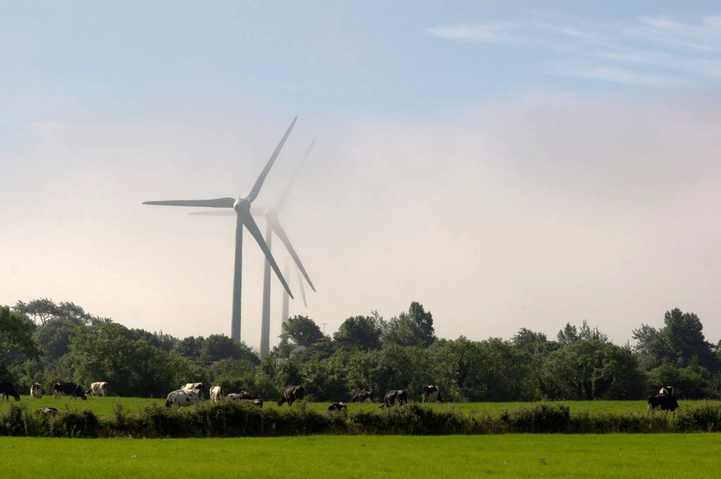
Content
What is LIFE?
LIFE in Estonia (2014-2020)
Applying successfully
LIFE 2021-2027: what’s new?

Slide 3

What is LIFE?

Slide 4
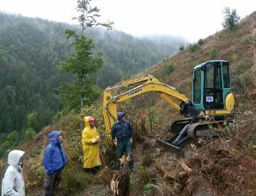
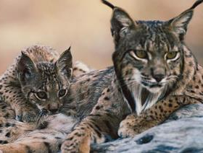
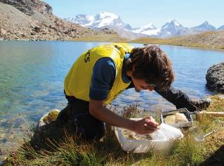
LIFE until now
LIFE is ongoing since 1992
Until 2019 more than 5400 projects in the fields of
  Nature & biodiversity
  All Other environmental sectors
  Climate action
  Governance and information

Slide 5
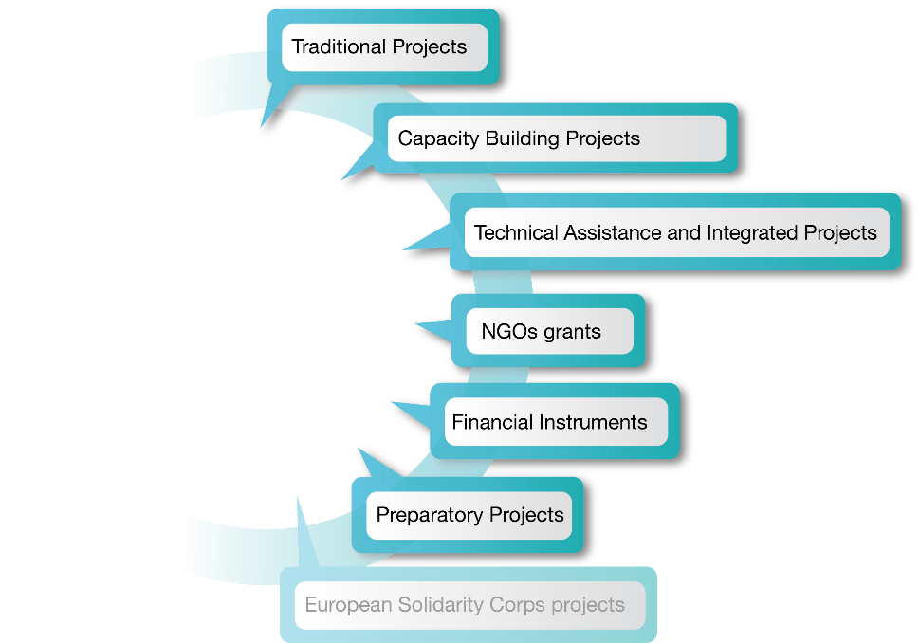
What is LIFE financing?
Notes:
ESC projects - no specific LIFE ESC Calls since 2017
2019 Call puts additional emphasis on, inter alia, response to environmental and climate challenges, including disaster prevention, preparedness and recovery (excluding immediate disaster response).
For further information:
https://europa.eu/youth/solidarity/organisation_info_en
https://ec.europa.eu/youth/annual-work-programmes_en

Slide 6
The "traditional" projects – will become "Standard Action Projects"
For whom?
All legal persons registered in the EU
For what?
Pursuit of general and specific objectives of the 6 priority areas
Additional focus on thematic priorities and on project topics (LIFE Multi-Annual Work Programme 2018-2020)
Average size and duration?
1 to 5 beneficiaries; EU contribution: €500,000 to €1.5 million; 3/5 years (but LIFE is flexible)
Co-funding rate?
Max. 55% (with few exceptions) in 2014-2020, min 60% as of 2021

Slide 7
LIFE in Estonia
2014-2020

Slide 8
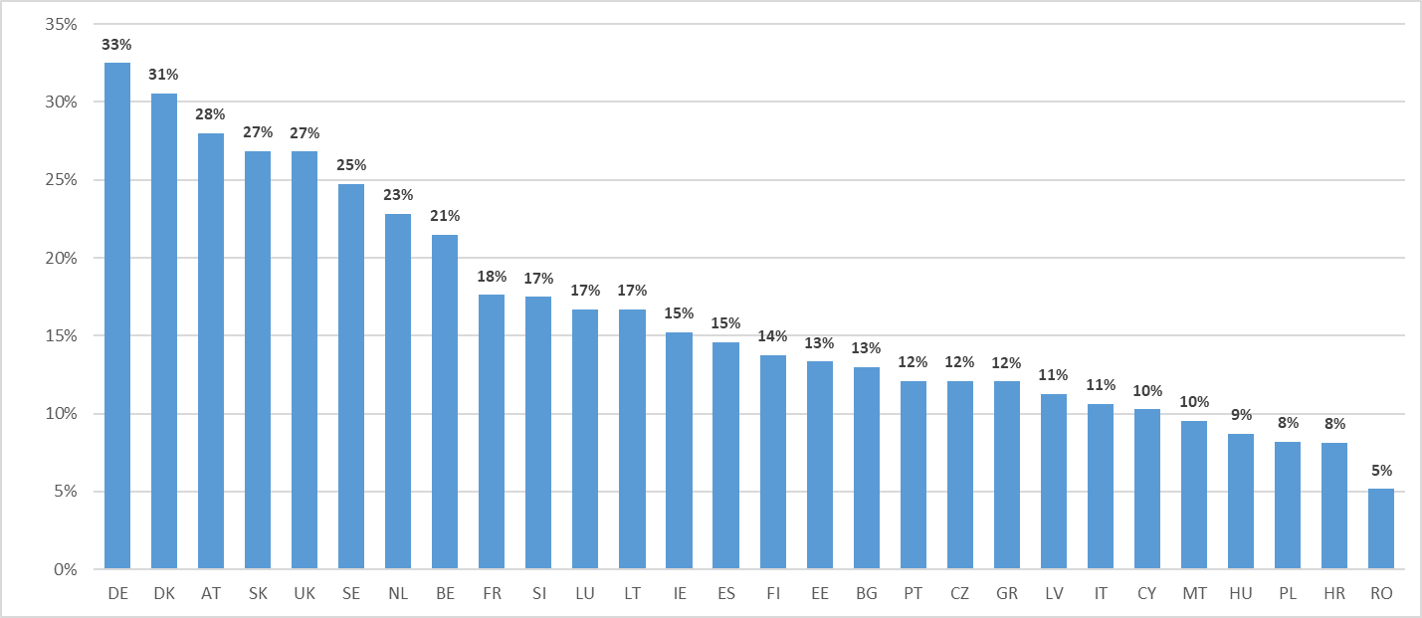
2014-2019 Success Rate Traditional Projects
(Sub-Programme Environment and Climate Action)

Slide 9
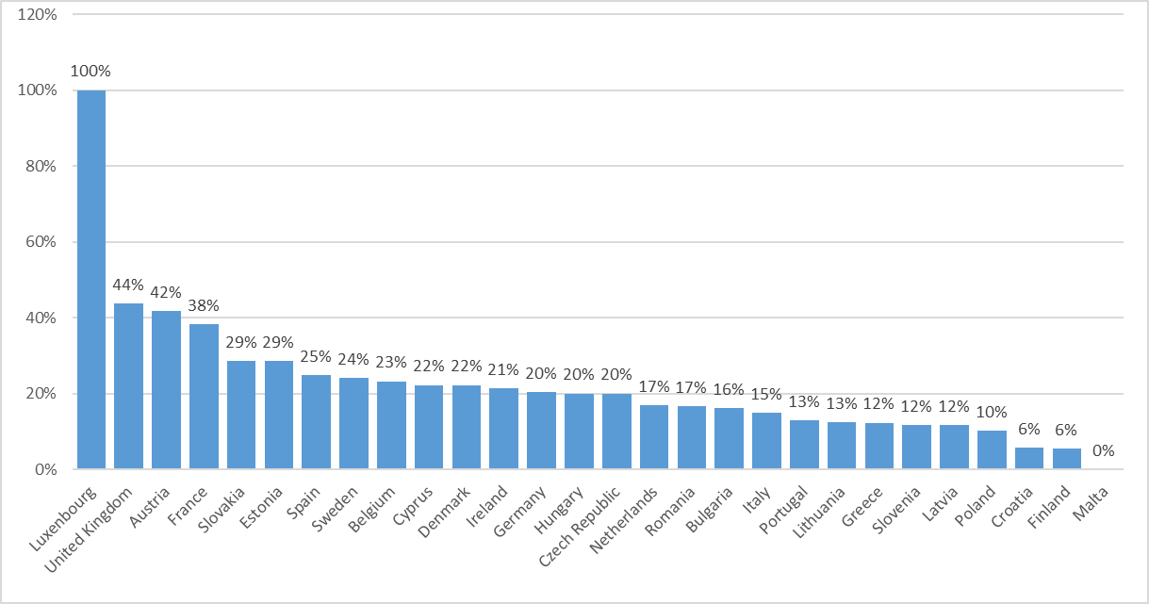
CNs - Success Rate (invited to 2nd Stage)*
* ENV traditional projects under 2020 call

Slide 10
Applying successfully: how does it work?

Slide 11

KEY CHALLENGES
There is significant competition for LIFE funds
It takes time and money to prepare an application – don’t wait until the last moment!
Proposals that fail are poorly prepared or simply not as good as the others, funding is limited

Slide 12
MUST READ
LIFE Web site https://ec.europa.eu/easme/en/life – It contains everything you need: in particular LIFE project database
LIFE Regulation and Multi-annual work-programme
Call document and Description of the Action
Eventually, specific information, guidelines designed by your National Contact Point
Evaluation comments from previous submissions/ from Concept note stage

Slide 13

CONCEPT NOTE EXPERIENCE
Until 2020!
Information on the baseline (scope and extent of the problem, expected change)
Actions listing vs main actions list and description
Timeline and use of budget
Quantification of impacts (absolute and relative terms)
Partnership and involvement

Slide 14

DESIGN FULL PROPOSAL
Until 2020!
Good design
Common problems
Solid analysis of the problem, state of play and solution proposed (baseline)
Robust assessment of impacts over the life cycle of the solution proposed
Clear strategy on how to sustain and multiply the impacts
Key stakeholders involved (incl. users)
Insufficient background information (why, who and how)
Rationale for projects is defined during the project
Objectives too broad, too many
Poor partnership (partners don’t fit regarding know-how or insufficient budget)
Over-optimistic / unrealistic or lack of quantification of impacts
Replication confused with networking and dissemination
Vague plans to sustain the project/results after project end

Slide 15
LIFE in 2021-2027
What’s new?

Slide 16

LIFE will continue after 2020
New EU Multiannual Financial Framework 2021-2027
New LIFE Regulation and new Multiannual Work Programme 2021-2024
Inclusion of new sub-programme ‘Clean Energy Transition’
Revised EU co-funding rates
Increased LIFE budget

Slide 17
The European Commission proposal in detail
Increased budget from 3.4 billion EUR (2014-2020) to 5.4 billion EUR (2021-2027)
STILL the only EU programme with only focus on: environment, nature conservation and climate action
2 fields with 2 sub-programmes each including a new one linked to Clean Energy transition
Builds on ‘previous’ LIFE, reinforcing and adapting:
  some types of projects/actions (e.g.: Integrated Projects)
  award criteria: synergies, replication, uptake of other EU programmes

Slide 18




Structure
To contribute:
to a clean, circular, energy-efficient, low-carbon and climate-resilient economy, transition to clean energy
to the protection and improvement of the quality of the environment
to halting and reversing biodiversity loss
Sub-programmes
Proposed budget split
Nature and biodiversity:
2,2 Bln € (39,4%)
Environment Field
Circular economy
and quality of life:
1,3 Bln € (24,8%)
Climate mitigation and adaptation
1 Bln € (18%)
Climate Action Field
Clean energy transition
1 Bln € (18%)
NEW

Slide 19
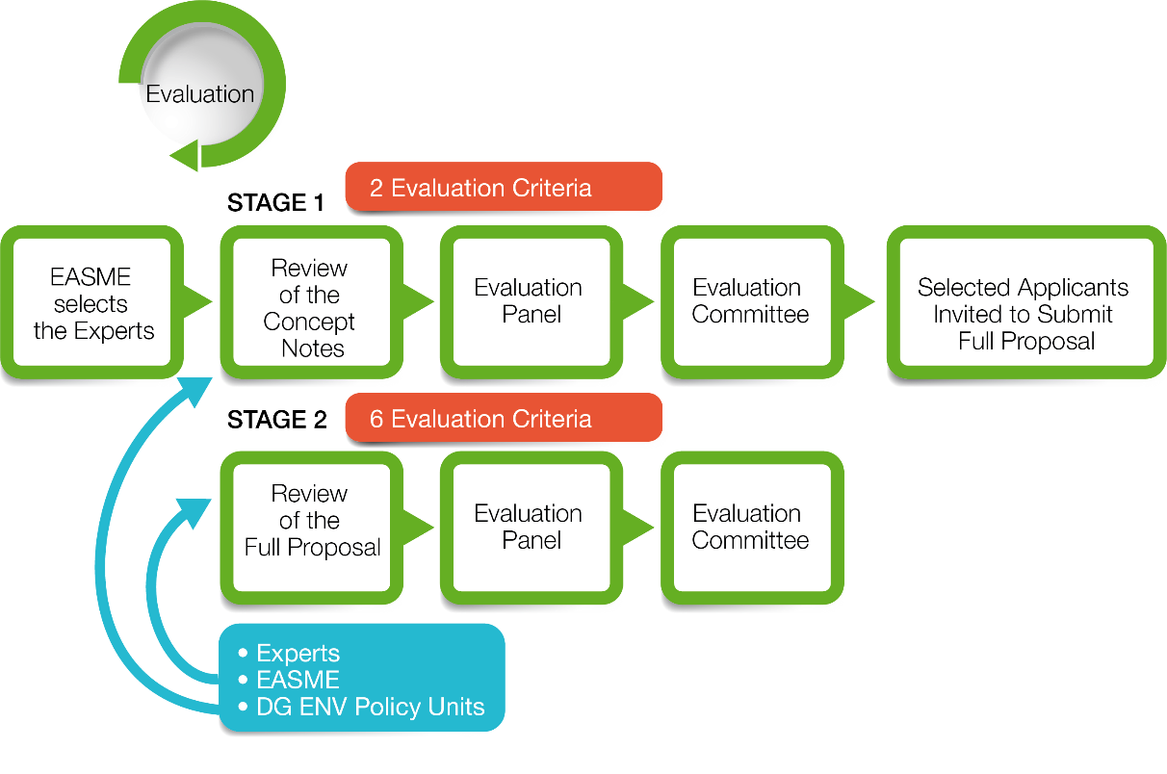
Environment Field – Two stage

Slide 20
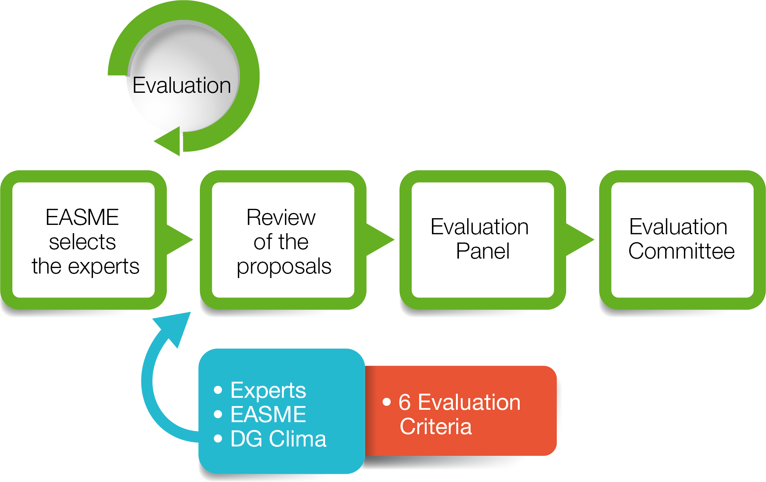
Climate Action Field – One stage

Slide 21
LIFE “The people’s Programme”
One of the most visible EU programs on the ground
Empowers and enables small and big
Support to start-ups now possible
Support to local initiatives also possible
Close to the needs of civil society also during COVID crisis

Slide 22
Curious to know more about LIFE?
LIFE webpage https://ec.europa.eu/easme/en/life
Get in touch with your National Contact Point
Ask questions to EASME-LIFE-ENQUIRIES@ec.europa.eu
Project database https://ec.europa.eu/environment/life/project/Projects/index.cfm

Slide 23
Thank you for your attention!

