Slide 1
Experiences from CMIP6 climate data analysis
Erko Jakobson
Teams, 06.11.2023
Notes:
1
Measurement Data Processing

Slide 2
CMIP6 – Coupled Model Intercomparison Project Phase 6
WCRP – World Climate Research Programme
Global coupled climate models, but differences in resolutions, used model parameters, calculated SSP-s etc.
Radiative forcing scenarios for future climate:
SSP – Shared Socioeconomic Pathways (SSP1-1.9; SSP2-2.6; SSP2-4.5; SSP3-7.0; SSP5-8.5)
RCP – Representative Concentration Pathways
CMIP6 data freely available:
https://cds.climate.copernicus.eu/
IPCC AR6 Interactive Atlas
https://cds.climate.copernicus.eu/cdsapp#!/dataset/projections-climate-atlas?tab=form
2

Slide 3
How to present future climate?
Timeseries:
results have bias problem
you have to select SSP
Global warming levels (GWL):
no bias problem;
no direct connection to time;
you can describe local climate, when GWL reaches 1.5 C, 2.0 C, 3.0 C etc
Which steps are needed for GWL approach:
Download regional data and global T2m;
Global warming levels years for each model;
Calculate and present mean result
Seasonal data
Calculation of different parameters (extremes etc)
3

Slide 4
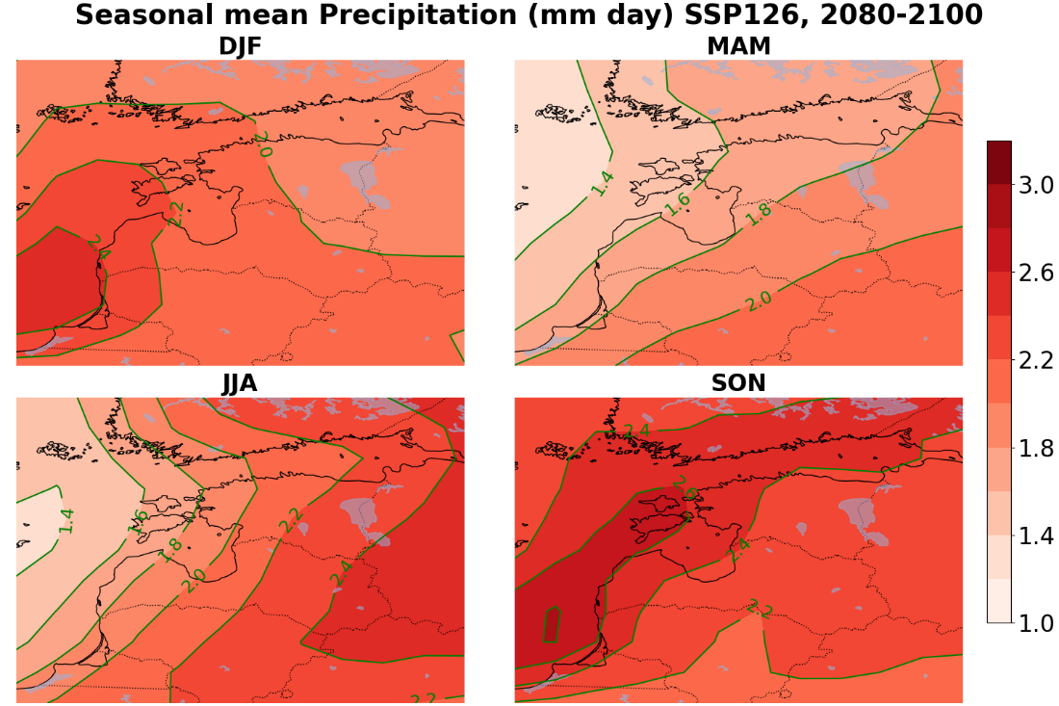
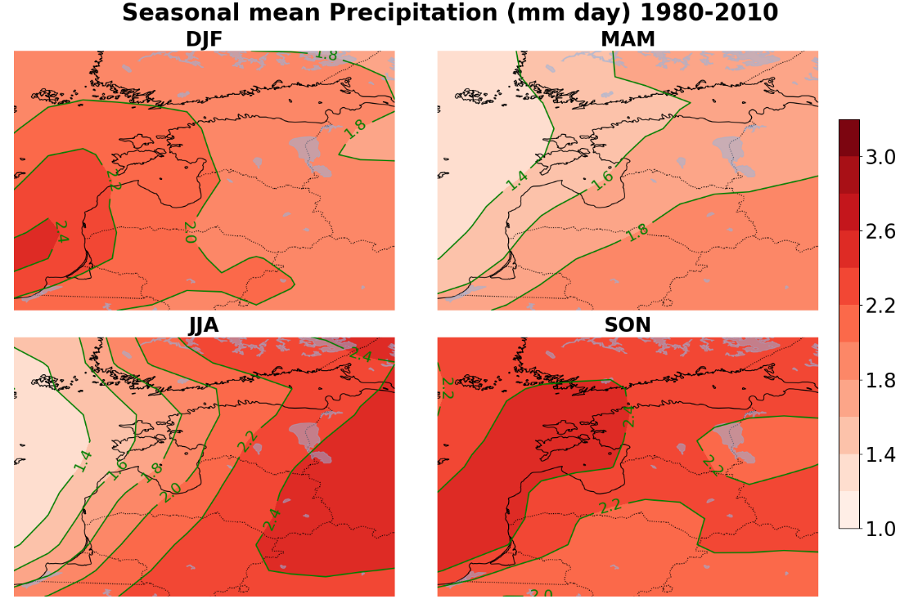
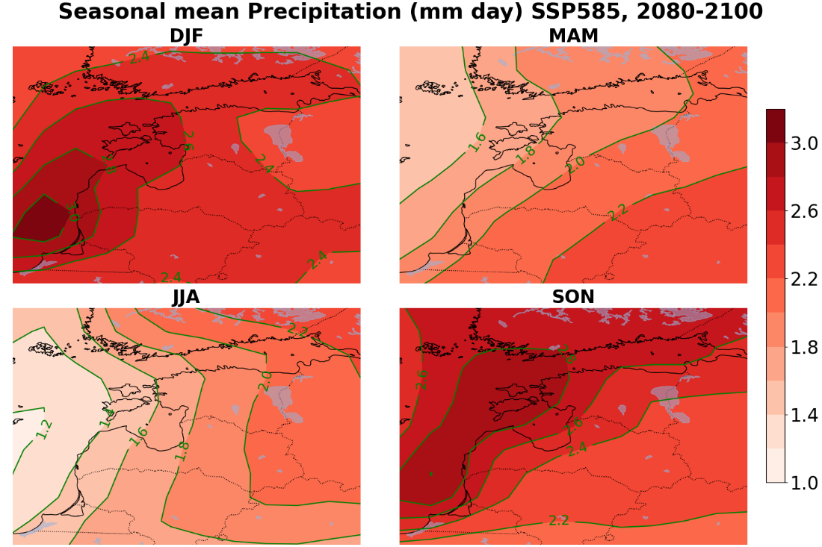
Precipitations

Slide 5
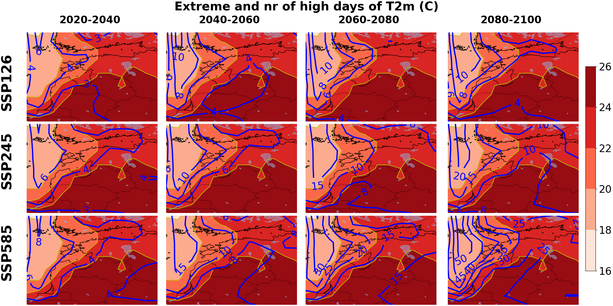
Extreme temperature from the period 1980 – 2010 (colors) Number of days per year exceeding historical extreme temperatures. Colors present extreme temperatures, isolines number of days.

