Slide 1
The implementation of the LIFE Programme in Italy
and the activities of the National Contact Point (NCP)
LIFE NCP Team IT
Event
Place, Date
Italian Ministry of the Environment and Energy Security (MEES)

Slide 2
The implementation of the LIFE Programme in Italy

Slide 3
The LIFE Programme in Italy: facts and figures (1992-2022)

Slide 4
The activities of the National Contact Point (NCP)

Slide 5
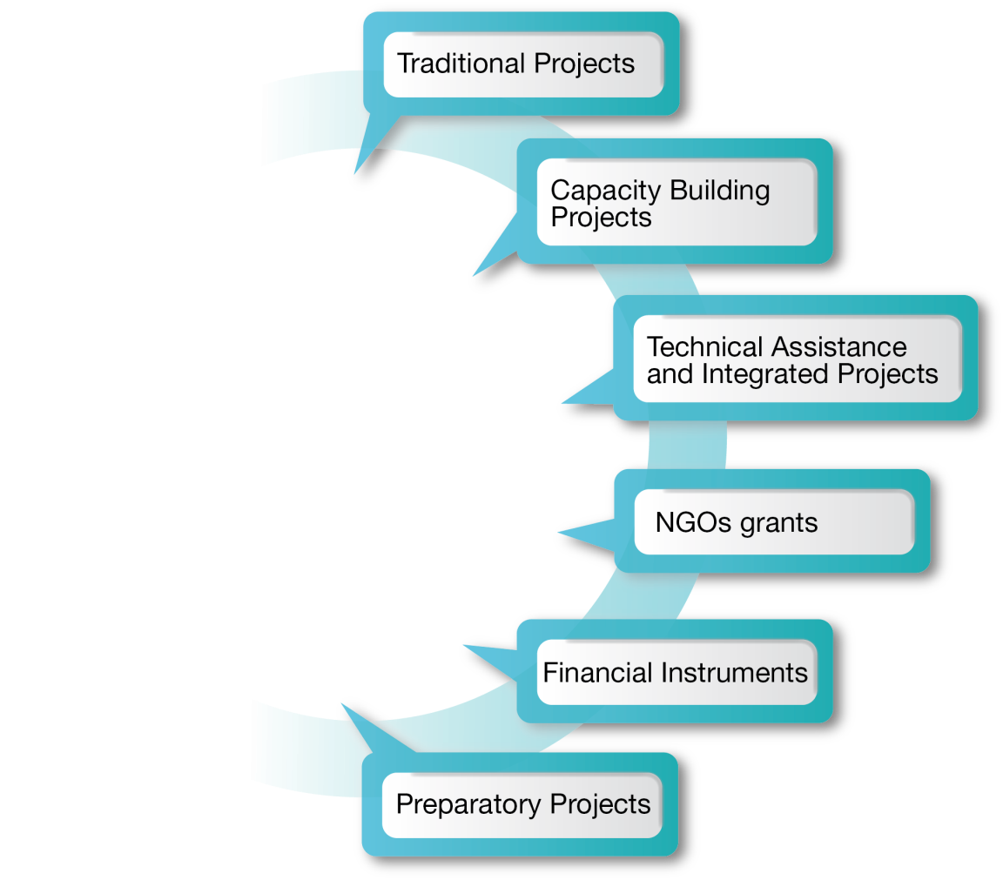
FOCUSED SUPPORT TO APPLICANTS
ORGANISATION OF EVENTS
PARTICIPATION IN EVENTS
What are the main activities of the Italian LIFE NCP?
COMMUNICATION ACTIONS
SPECIFIC ACTIONS TO PROMOTE PROJECTS
ACTIONS FOR SYNERGIES/
COMPLEMENTARITY/
REPLICATION

Slide 7
Thank you!
www.mase.gov.it/pagina/life
NCP LIFE Italia
LIFE NCP Team IT - MEES:
Federico Benvenuti
Simonetta Pulicati
Carmen Gangale
Giulia Pérez Almodóvar
Marco Rinaldi
NCP LIFE IT
ncp_life_it
NCP LIFE Italia
E-mail: life@mase.gov.it
Phone: +39 06 5722 8150 – 8231 - 8254 - 8174 - 8181

