Slide 1


Implementation of national climate change adaptation activities in Estonia (LIFE SIP AdaptEst)
Kai Rosin
Estonian Environment Agency
06.11.2023

Slide 2



Project AdaptEst
Implementation of national climate change adaptation activities in Estonia (LIFE21-IPC-EE-LIFE-SIP AdaptEst/101069566 )
Project duration 2023-2032
Budget ca 19 MEUR
17 partners, coordinated by the Ministry of Climate
Estonian Environment Agency, Environmental Board, Environmental Research Centre, University of Life Sciences, Forest Management Centre, Information Technology Centre of the Ministry of the Environment, Estonian Museum of Natural History, Estonian Fund of Nature, Wildlife Estonia, Geological Survey of Estonia, University of Tartu, Tallinn University, Tallinn University of Technology, Estonian Private Forest Union, Tartu Hunting Club, Lynxland non-profit organization
Project aims to implement „National Adaptation Strategy until 2030“
Notes:
Current Climate projections are from year 2015 and are not very detailed

Slide 3
LIFE-SIP AdaptEst – Work Packages (1)
WP1
Project coordination, management and monitoring activities
Ministry of Climate
WP2
Management of the Alam-Pedja nature conservation area as a pilot
Environmental Board
WP3
Mapping of water bodies affected by climate change and developing support measures for resilience
Estonian Environmental Agency

Slide 4
LIFE-SIP AdaptEst - Work Packages (2)
WP4
Compilation of National water re-use strategy
Environmental Research Centre
WP5
Ensuring healthy, adaptable, and diverse forests in a changing climate
University of Life Sciences
WP6
Reducing the effects of anthropogenic factors in a changing climate by removing obsolete dams, restoring the spawning areas and habitats of important water bodies and restocking critically endangered fish species
Forest Management Centre

Slide 5
LIFE-SIP AdaptEst - Work Packages (3)
WP7
Development of monitoring, information, and support system
Estonian Environmental Agency
WP8
Updating climate scenarios
Estonian Environmental Agency
WP9
Sustainability, replication and exploitation of project results
Ministry of Climate

Slide 6


Deliverables WP8 (atmospheric)
The main atmospheric climate variables
Precipitaton
Solar radiation
Temperature
Humidity
Wind
Clouds
Snow cover
Air quality (concentrations of aerosols and gases)
etc
Climate indices
Number of frost and ice days
Number of summer days and tropical nights
Extreme values during a specific period
Exceeding specific limits (percentile)
Warm and cold spell duration
Growing season lenght
Annual count of days when the precipitation is greater than adefined limit
Analyses based on percentiles
Return periods
etc
Comprehensive overview of the past and future climate of Estonia up to year 2100
Summary and suggestions for policymakers
Open datasets (DataDOI)
Delivery 01/2027
Notes:
Ca 15 atmospheric variables, main are listed here

Slide 7
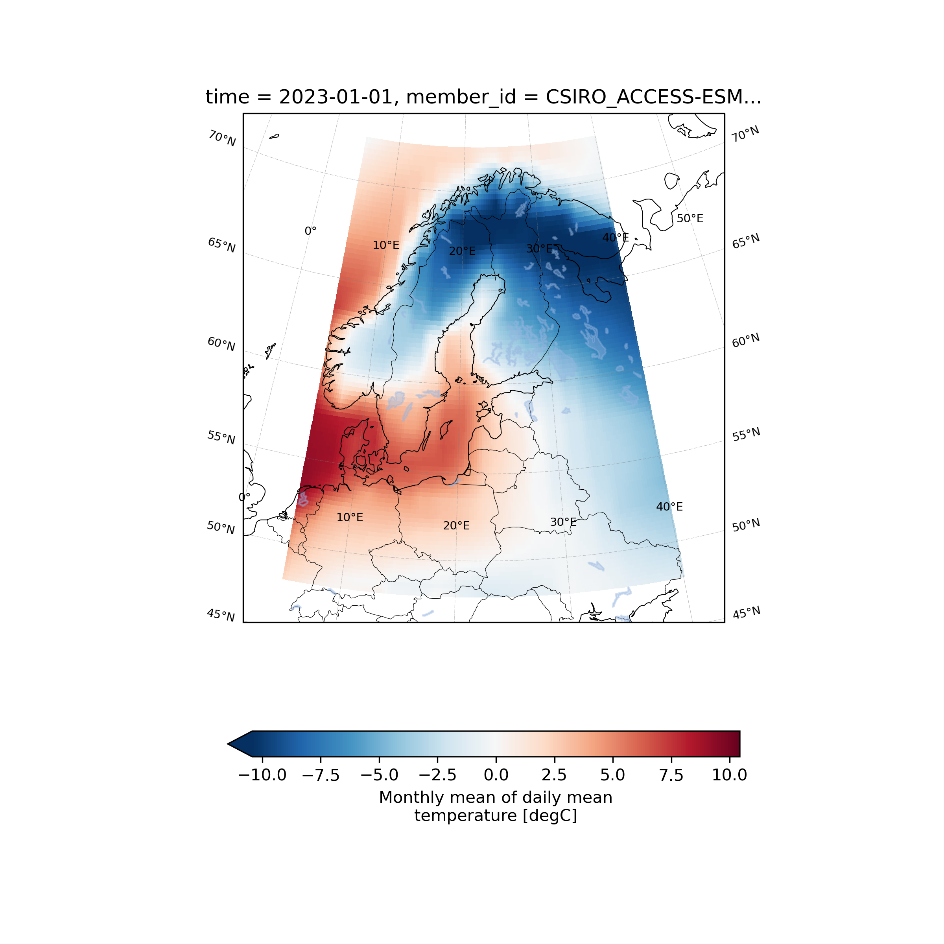
Background
The Northern European region
Climate models from CMIP6, EUROCORDEX ​
Future climate projections based on Global Warming Levels (GWL​)

Slide 8


Deliverables WP8 (marine)
The main marine physical and hydrochemical variables
Temperature
Salinity
Water level
Sea ice
Currents
Waves
etc
Impact of climate change on
Extreme sea levels
Marine heatwaves
Sea ice extent
Stratification conditions
Water dynamics
Water quality
Biodiversity
etc
Comprehensive overview of the past and future climate of Estonia up to year 2100
Summary and suggestions for policymakers
Open datasets
Delivery 01/2027
Notes:
Ca 20 marine variables, main listed here

Slide 9
Thank you!

